Slide 1
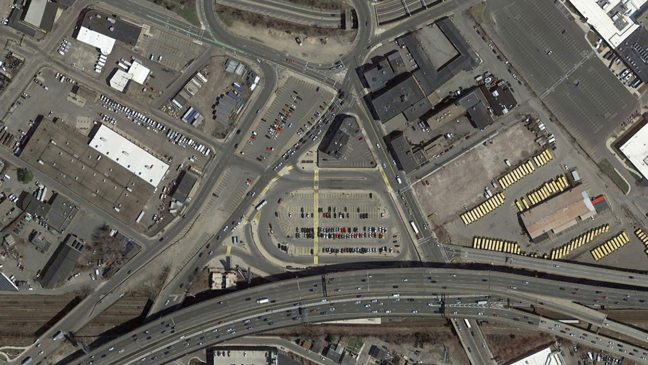
MBTA Sullivan Square Station
Lower Busway & Parking Lot Reconstruction
Public Meeting
April 5, 2018

Slide 2
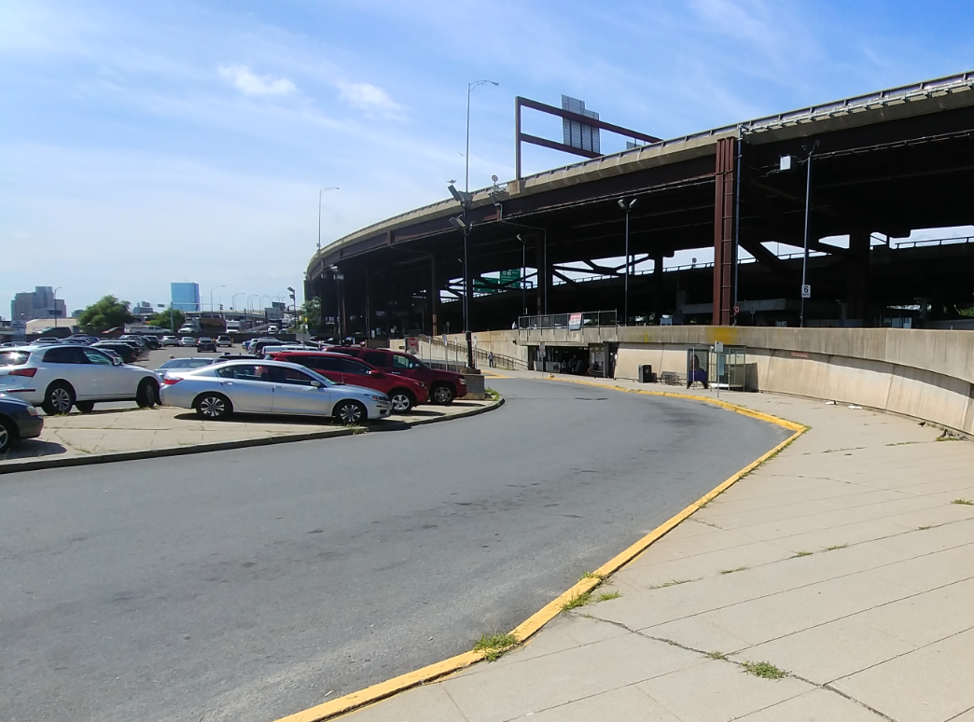
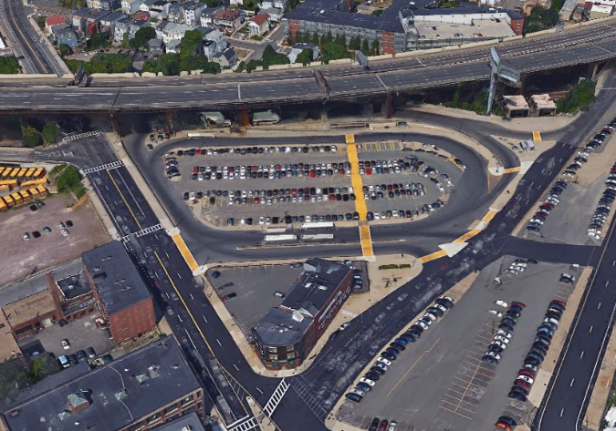
MBTA Sullivan Square Station
Lower Busway & Parking Lot Reconstruction
Project Proponent: Wynn Development
Developer/Funding: Wynn Development
Contractor: D.W. White Construction
Designers: AECOM/Howard Stein Hudson
Construction Cost: $4.5M
Start Date: April, 2018
Completion Date: October, 2018

Slide 3
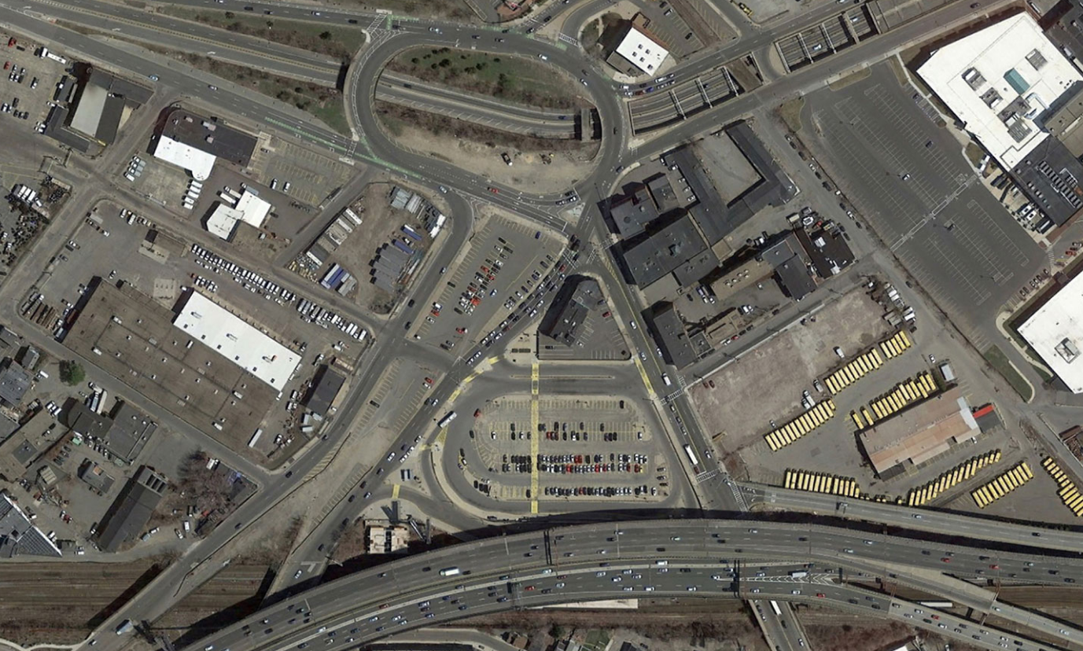
Project Location
MAIN STREET
RUTHERFORD AVE
SOUTH TO BOSTON
RUTHERFORD AVE
ALFORD STREET
NORTH TO EVERETT
D STREET
BEACHAM STREET
MAIN STREET (MYSTIC AVE)
SPICE STREET
CAMBRIDGE STREET
MAFFA WAY (BROADWAY)
I-93 N OFFRAMP
WEST TO SOMERVILLE
WEST TO CAMBRIDGE
INTERSTATE 93

Slide 4
Project Location
MAIN STREET
RUTHERFORD AVE
SOUTH TO BOSTON
RUTHERFORD AVE
ALFORD STREET
NORTH TO EVERETT
D STREET
BEACHAM STREET
MAIN STREET (MYSTIC AVE)
SPICE STREET
CAMBRIDGE STREET
MAFFA WAY (BROADWAY)
I-93 N OFFRAMP
WEST TO SOMERVILLE
WEST TO CAMBRIDGE
INTERSTATE 93

Slide 5
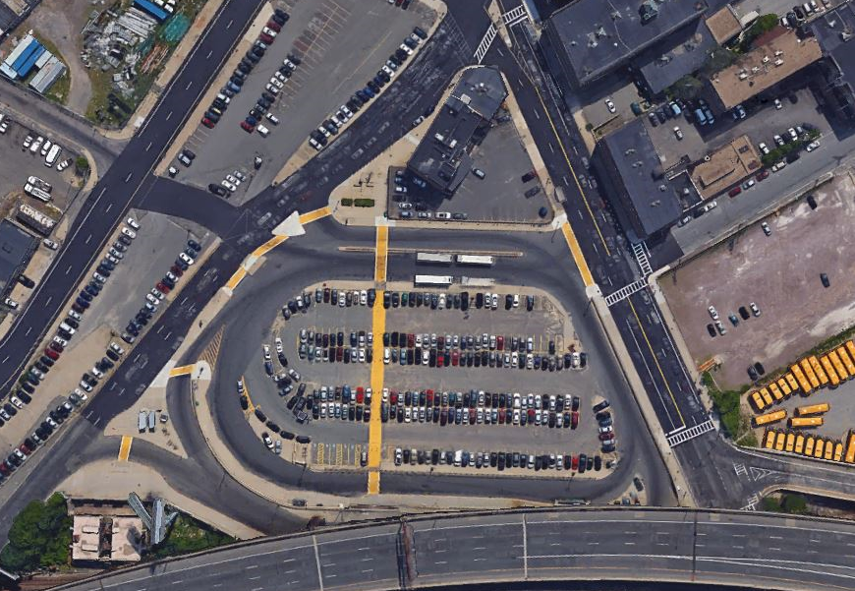
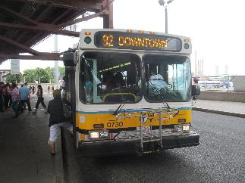
Existing Operations
Station Facts
Parking capacity of 222 spaces.
130% daily utilization rate.
Nearly 8,000 bus boardings each weekday (5th busiest bus station).
Over 600 buses for 12 routes serve Sullivan each weekday.
Between 2009 and 2012, ridership on local bus routes increased by 20%.
BEACHAM STREET
MAFFA WAY
MAIN STREET
CITY OF BOSTON PARKING LOTS
SPICE STREET
MBTA BUS ONLY AREA
MAFFA WAY
MBTA PARKING LOT
CAMBRIDGE STREET
I-93 N
OFFRAMP
MBTA LOWER BUSWAY
MBTA UPPER BUSWAY
(BELOW INTERSTATE 93)

Slide 6
Existing Operations – Parking Services
Station Facts
Parking capacity of 222 spaces.
130% daily utilization rate.
Nearly 8,000 bus boardings each weekday (5th busiest bus station).
Over 600 buses for 12 routes serve Sullivan each weekday.
Between 2009 and 2012, ridership on local bus routes increased by 20%.
P
PARKING MOVEMENTS
BEACHAM STREET
MAFFA WAY
MAIN STREET
CITY OF BOSTON PARKING LOTS
SPICE STREET
MBTA BUS ONLY AREA
P
MAFFA WAY
MBTA PARKING LOT
P
CAMBRIDGE STREET
I-93 N
OFFRAMP
MBTA LOWER BUSWAY
MBTA UPPER BUSWAY
(BELOW INTERSTATE 93)

Slide 7
Existing Operations – Bus Operations
Station Facts
Parking capacity of 222 spaces.
130% daily utilization rate.
Nearly 8,000 bus boardings each weekday (5th busiest bus station).
Over 600 buses for 12 routes serve Sullivan each weekday.
Between 2009 and 2012, ridership on local bus routes increased by 20%.
B
BUS MOVEMENTS
BEACHAM STREET
MAFFA WAY
MAIN STREET
B
CITY OF BOSTON PARKING LOTS
SPICE STREET
B
MBTA BUS ONLY AREA
B
B
MAFFA WAY
MBTA PARKING LOT
CAMBRIDGE STREET
B
B
I-93 N
OFFRAMP
MBTA LOWER BUSWAY
MBTA UPPER BUSWAY
(BELOW INTERSTATE 93)

Slide 8
Existing Operations – Parking Services and Bus Operations
Station Facts
Parking capacity of 222 spaces.
130% daily utilization rate.
Nearly 8,000 bus boardings each weekday (5th busiest bus station).
Over 600 buses for 12 routes serve Sullivan each weekday.
Between 2009 and 2012, ridership on local bus routes increased by 20%.
P
PARKING MOVEMENTS
B
BUS MOVEMENTS
BEACHAM STREET
MAFFA WAY
MAIN STREET
B
CITY OF BOSTON PARKING LOTS
SPICE STREET
B
MBTA BUS ONLY AREA
B
B
P
MAFFA WAY
MBTA PARKING LOT
P
CAMBRIDGE STREET
B
B
I-93 N
OFFRAMP
MBTA LOWER BUSWAY
MBTA UPPER BUSWAY
(BELOW INTERSTATE 93)

Slide 9
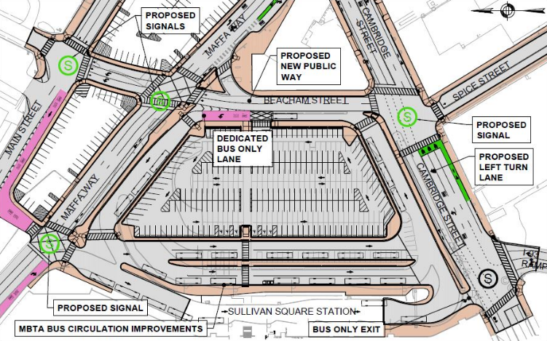
Proposed Design
Operational Features:
New public right-of-way between Cambridge Street and Maffa Way.
Separation of Parking Lot and Busways.
197 Parking Spaces.
Relocated bus Layover Area.
New additional Lower Busway.
4 newly signalized intersections.
New bus only entrance via Main Street.
New Upper Busway exit to Cambridge Street.
Infrastructure Improvements:
New bus shelters
New lighting system.
New drainage system.
New security infrastructure.
New pavement and striping.
New traffic and wayfinding signage.

Slide 10
Service During Construction
Bus Service:
All 12 MBTA bus routes serving Sullivan Square Station will remain fully operational during construction.
A phased construction effort will require temporary closures of busways.
Temporary wayfinding signage will be posted throughout construction.
Parking Service:
Parking payment method has been transitioned to pay-by phone.
Capacity during construction will be reduced including periods of full closure.
Lot entry and exit will be relocated during construction.
Alternative MBTA parking is available at the MBTA’s Station Landing Garage (80 Station Landing, Medford).
Station Landing Garage contains pedestrian bridge access to MBTA Wellington Station.
Parking lot detour signage will be posted throughout construction.
Orange Line Service:
No changes to service due to construction.
Sullivan Square Station will remain accessible throughout construction.

Slide 11
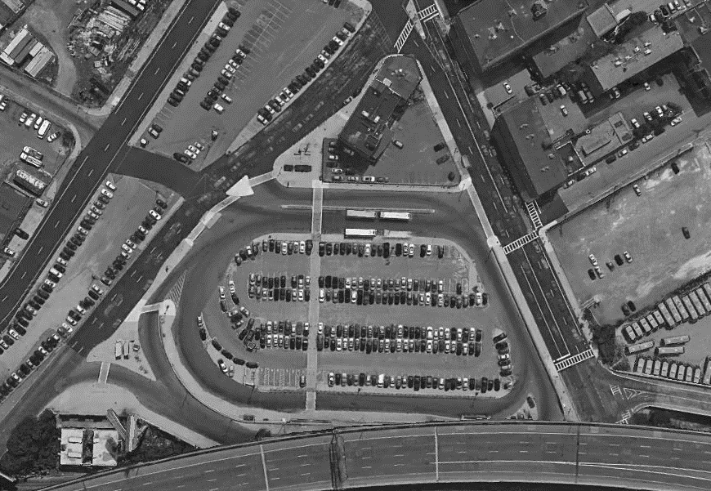
Construction – Phase 1 – 2 weeks (April 19 – May 3)
Activities:
Remove median in busway
Realign busway
Construct temp busway
MAFFA WAY
MBTA Service:
Parking reduced by 40%
222 to 134 spaces
Relocated parking lot entry
Relocated pick-up/drop-off
No change to bus service
No change to station access
MAIN STREET
P
MAFFA WAY
CAMBRIDGE STREET
P
CONSTRUCTION AREA

Slide 12
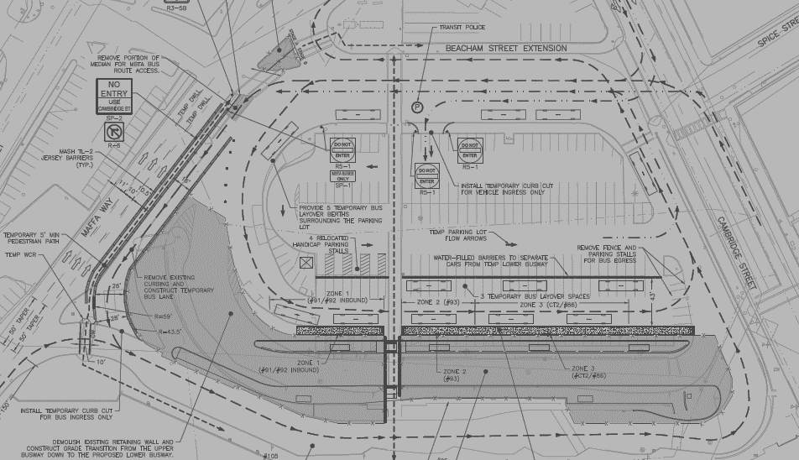
Construction – Phase 2 – 10 weeks (May 4 – July 13)
Activities:
Re-alight retaining wall between the upper and lower busways
Reconstruct lower busway
MAIN STREET
MBTA Service:
Parking reduced by 40%
222 to 134 spaces
Relocated parking lot entry
Relocated pick-up/drop-off
Lower busway service relocated to temp busway. (routes 86, 91, 92 inbound, 93, and CT2)
No change to station access
P
MAFFA WAY
CAMBRIDGE STREET
P
CONSTRUCTION AREA
TEMPORARY LOWER BUSWAY
CONSTRUCTION AREA
UPPER BUSWAY

Slide 13
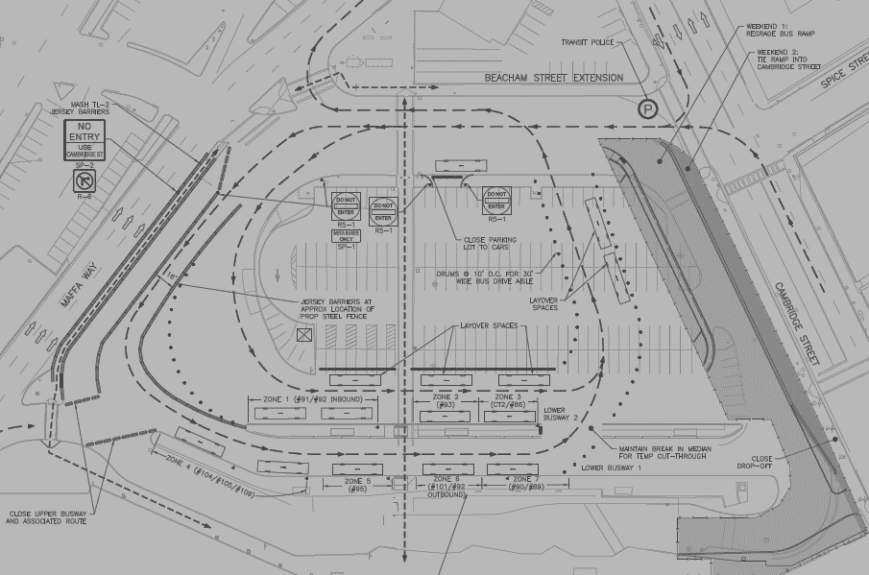
Construction – Phase 2a – 2 weekends (6/30-7/1 & 7/7-7/8)
Activities:
Re-grade busway along Cambridge Street
MAFFA WAY
MBTA Service:
Parking lot closed.
Relocated pick-up/drop-off
Lower busway service relocated to temp busway (routes 86, 91, 92 inbound, 93, and CT2).
Upper busway service relocated to new Lower Busway 1 (routes 89, 90, 92 outbound, 95, 101, 104, 105, 109).
Station access from Cambridge Street west detoured.
MAIN STREET
MAFFA WAY
CONSTRUCTION AREA
CAMBRIDGE STREET
LOWER BUSWAY 2
LOWER BUSWAY 1

Slide 14
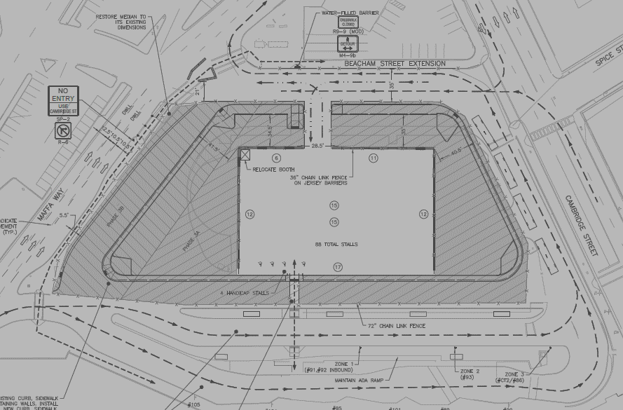
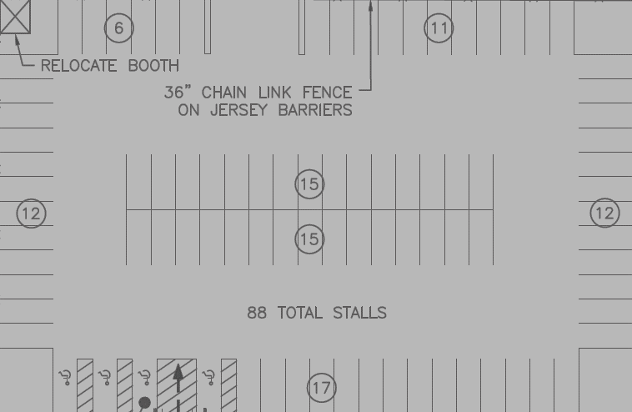
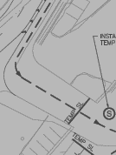
Construction – Phase 3 – 10 weeks (July 14 – September 22)
Activities:
Reconstruct parking lot perimeter
MBTA Service:
Parking reduced by 60%
222 to 88 spaces
Relocated parking lot entry and exit
Pick-up/drop-off area re-opened.
Lower busway service relocated to Lower Busway 1 (routes 86, 91, 92 inbound, 93, and CT2).
Upper Busway Service Restored (routes 89, 90, 92 outbound, 95, 101, 104, 105, 109).
MAFFA WAY
MAIN STREET
P
P
CONSTRUCTION AREA
MAFFA WAY
CONSTRUCTION AREA
CAMBRIDGE STREET
LOWER BUSWAY 1
UPPER BUSWAY

Slide 15
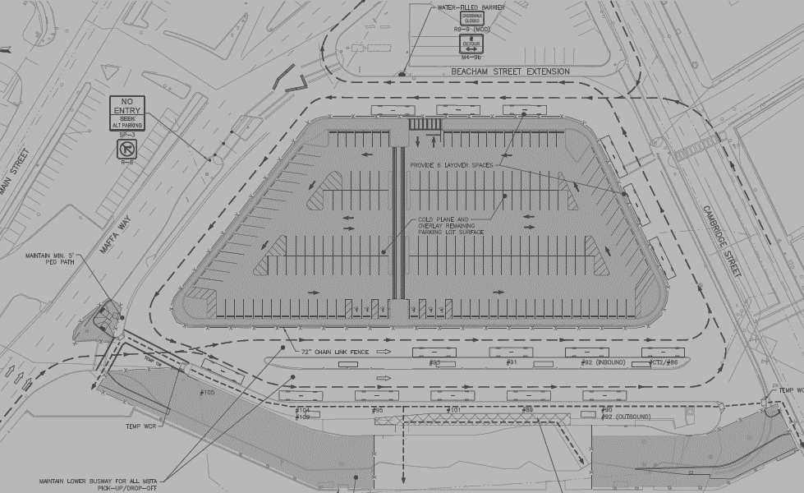
Construction – Phase 4 – 4 weeks (September 23 – October 21)
Activities:
Reconstruct parking lot interior
Regrade Upper Busway entry and exit
MAFFA WAY
MBTA Service:
Parking lot closed
Lower busway service relocated to Lower Busway 2 (routes 86, 91, 92 inbound, 93, and CT2).
Upper Busway Service relocated to Lower Busway 1 (routes 89, 90, 92 outbound, 95, 101, 104, 105, 109).
Station access detoured from Maffa Way and Cambridge Street west
MAIN STREET
MAFFA WAY
CONSTRUCTION ARA
CAMBRIDGE STREET
LOWER BUSWAY 2
CONSTRUCTION AREA
LOWER BUSWAY 1
CONSTRUCTION AREA

Slide 16
Construction – Final Condition
Activities:
Work complete
MBTA Service:
Parking lot re-opened with 197 spaces available.
Parking lot accessed via Beacham Street
All 3 busways operational with some bus berth relocations.
Routes 89, 91, and CT2 relocated to Upper Busway
Routes 104, 105, 109 relocated to Lower Busway 1
Routes, 90, 92, and 93 relocated to Lower Busway 2
MAFFA WAY
MAIN STREET
BEACHAM STREET
BEACHAM STREET
P
MAFFA WAY
CAMBRIDGE STREET
LOWER BUSWAY 2
LOWER BUSWAY 1
UPPER BUSWAY

Slide 17
Public Communications Strategy
MBTA Flyer Drops
Prior to and during Construction
MBTA Alerts
Text Message Alerts
Email Alerts
MBTA Website
Project Specific Site is Currently Active (https://www.mbta.com/projects/sullivan-square-lower-busway-and-parking-lot-reconstruction
Informational Graphic Displays on Site

Slide 18
QUESTIONS?
or send questions to: sullivanquestions@mbta.com

