Slide 1
MBTA Contract No. X72PS01: Worcester Union Commuter Rail Station
Design and Engineering Services for Station Improvements
and Associated Track Work
October 1, 2018

Slide 2
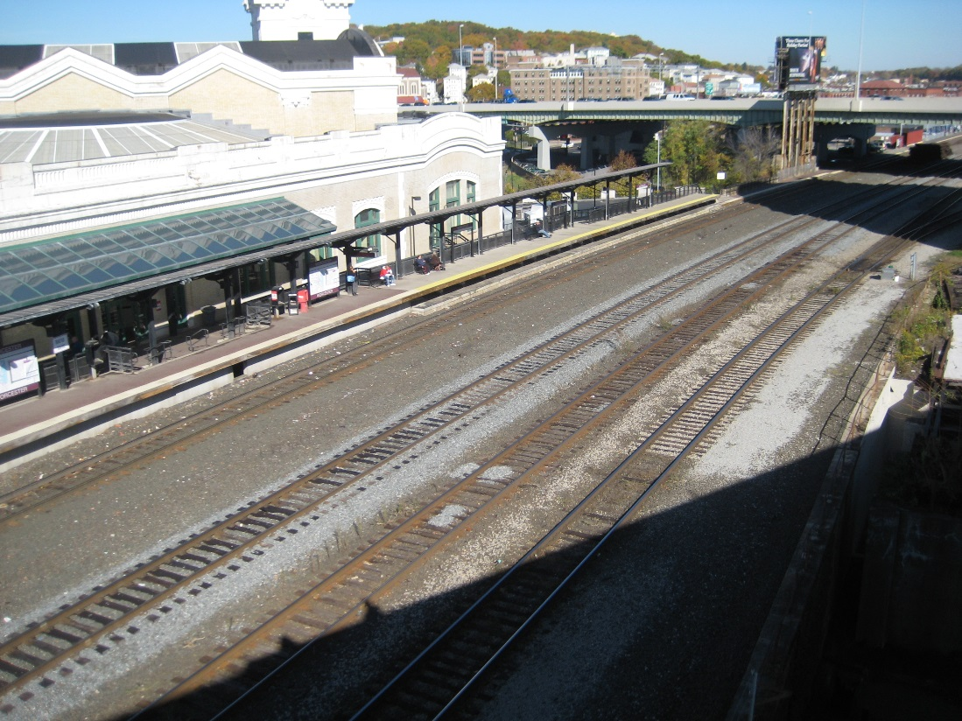
OVERVIEW
Contract No. X72PS01: Worcester Union Station
Design and Engineering Services for Station Improvements and Associated Track
Today’s Board action will provide for Design and Construction Phase Services for the Worcester Union Station Improvements and Track Work Project.
Proposed Center Platform
Existing Station

Slide 3
Project Elements
Contract No. X72PS01: Worcester Union Station
Design and Engineering Services for Station Improvements and Associated Track
The project consists of:
A new, fully-accessible (ADA/MAAB compliant) center island platform
New passenger connections to the existing Union Station building and parking lot, including stairs and redundant elevators at the east and west ends of the platform
Track upgrades, including reconstruction of the existing CP-44 interlocking
Signal upgrades
Proposed Replacement

Slide 4
Background
Contract No. X72PS01: Worcester Union Station
Design and Engineering Services for Station Improvements and Associated Track
Worcester’s Union Station is a historic station located in Washington Square in downtown Worcester, Massachusetts. Union Station is the terminal station on the MBTA’s Worcester Line, providing MBTA Commuter Rail service from Worcester to Boston’s South Station.
The existing MBTA railroad right-of-way (ROW) and the Worcester Redevelopment Authority’s (WRA’s) existing single side platform are on a viaduct. The MBTA ROW also passes beneath the elevated U.S. Interstate Route 290 (I-290) viaduct located immediately to the east of the station platform.
Passengers board trains via the single-sided platform located on the second floor of Union Station. The side platform is accessible via stairs or elevator.
With the current single-sided platform configuration, only one commuter rail train set can enter the station at a time.

Slide 5
Project Benefits
Contract No. X72PS01: Worcester Union Station
Design and Engineering Services for Station Improvements and Associated Track
Project benefits include:
Increased reliability
Reduced operating schedules
Capacity expansion options to meet current and future demand
ADA upgrades to fulfill code compliance requirements
Reduced station life cycle maintenance costs and lower energy consumption
An environmentally-friendly station
A fully integrated intermodal facility

Slide 6
Scope of Services
Contract No. X72PS01: Worcester Union Station
Design and Engineering Services for Station Improvements and Associated Track
The services under Contract X72PS01 will be delivered on a Task Order basis by Phase. Project Phases for this project are:
Phase I Pre-Design (0%-15%)
Phase II Preliminary Design (15% - 30%)
Phase III Design Development (30% - 75%)
Phase IV Final Design (75% - PSE)
Phase V Bid Phase
Phase VI Construction Phase Services
Design and Bid Phase services will be completed within 27 months. Construction phase services are anticipated to be provided for 24 months.

Slide 7
Request of the Fiscal and Management Control Board
Contract No. X72PS01: Worcester Union Station
Design and Engineering Services for Station Improvements and Associated Track
Staff request that the Fiscal and Management Control Board authorize the MBTA General Manager and CEO, or his designee, to execute MBTA Contract No. X72PS01: Design and Engineering Services for Station Improvements and Associated
Track Work for the Worcester Union Commuter Rail Station, with HDR Engineering, Inc. for an amount not to exceed $4,000,000.

