Slide 1
Red Line/Orange Line Improvement Program Update
Vehicle Procurement, Infrastructure Improvements,
State of Good Repair Improvements and Signal Upgrades
October 1, 2018

Slide 2
OVERVIEW
The following summary provides an update to the FMCB on the progress of the $1.98 billion Red Line/Orange Line Improvement Program; which includes new Vehicle Procurement, Infrastructure Improvements, State of Good Repair Improvements and Signal Upgrades.
This program supports the MBTA’s goal to improve the level of service on the Red Line to 3 minute headways and the Orange Line to 4.5 minute headways. This would increase capacity by 50% on the Red Line and 40% on the Orange Line from current rates.

Slide 3



Red Line/Orange Line Improvement Program
Red Line
Orange Line
Total $1,982.03M
NEW VEHICLE PROCUREMENT PROGRAM
$1,009.00M
INFRASTRUCTURE IMPROVEMENTS PROGRAM
$470.36M
SIGNALS UPGRADE PROJECTS
$350.95M
STATE OF GOOD REPAIR PROJECTS
$151.72M
3

Slide 4



Red Line and Orange Line Schedule by Project
Pilot
1st Production
Vehicle Procurement Program
Completed
OL Vehicles
RL Vehicles
Infrastructure Program – Orange Line
Wellington Yard Expansion Tracks 33-38
Orange Line Test Track
Wellington Maintenance Facility
Wellington Yard Rebuild
Infrastructure Program – Red Line
Red Line Test Track
Cabot Maintenance Facility & Cabot Yard Improvements
LEGEND
Manufacturing/Delivery
Pilot
1st Production
Design
Procurement
Construction
Interim Milestone to Support Vehicle Delivery - Completed
Interim Milestone to Support Vehicle Delivery

Slide 5
Red Line/Orange Line Schedule – Signals Upgrades
Signal Upgrades Program - Orange Line
Mainline Signal Upgrades Project
Signal Enhancements
Completed
Signal Upgrades Program - Red Line
Mainline Signal Upgrades Project
Signal Enhancements
LEGEND
Procurement
Design/Build
Procurement
MBTA Installation

Slide 6
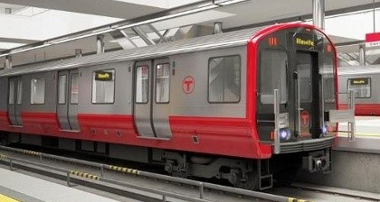
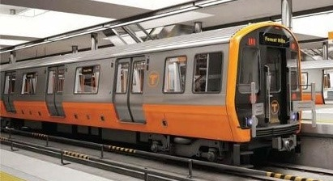
New Vehicle Procurement Program
New Vehicle Procurement Program
Total Project Value: $ 1,009,871,671
Expenditure to date: $ 188,490,884 Carbuilder Percent Complete: 18.66%
Replace 218 Red Line cars
34 new cars
Total = 252 vehicles
Replace 120 Orange Line cars
32 new cars
Total = 152 vehicles

Slide 7

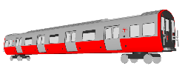
Vehicle Procurement Project Status – Current/Look Ahead
Pilot
1st Production
Vehicle Procurement Program
2016 | 2017 | 2018 | 2019 | 2020 | 2021 | 2022
OL Vehicles
  ● OL Pilot Car Qualification & Acceptance Testing - (through December 2018)
  ● OL Production Delivery from Springfield Facility Starts - (December 2018)
  ● OL Production Acceptance Testing Begins - (January 2019)
Pilot
1st Production
RL Vehicles
  ● RL Carbody FAI - (November 2018)
  ● RL Complete Vehicle FAI (Changchun) – (February 2019)
  ● RL Delivery of Pilot Cars - (March 2019)
LEGEND
Design
Manufacturing/Delivery

Slide 8
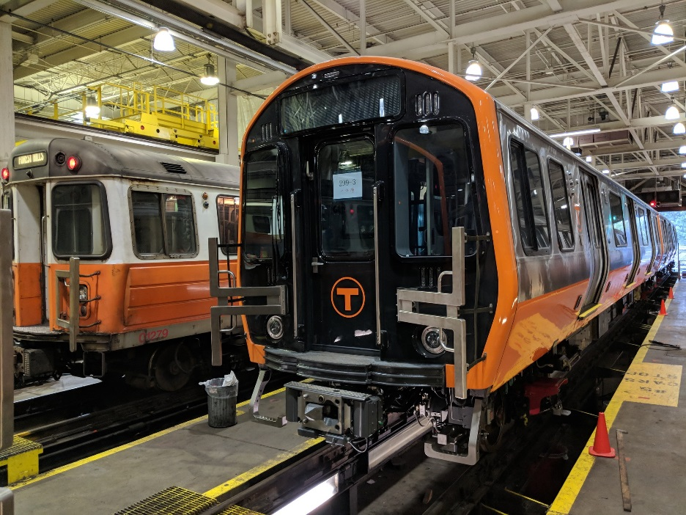
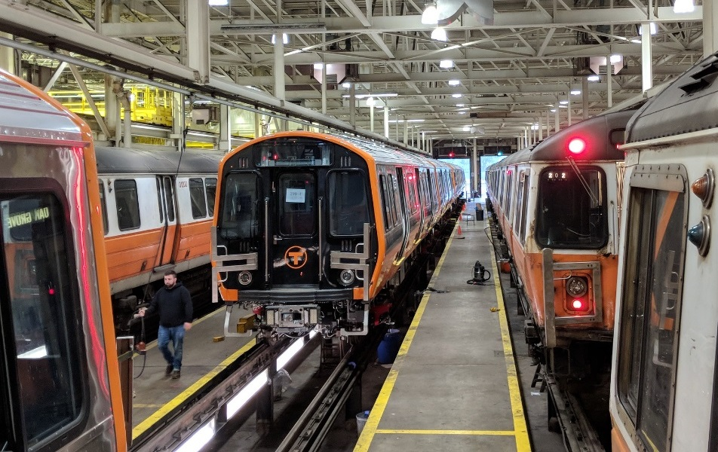
Orange Line Vehicle Procurement Project Status
A full vehicle level First Article Inspection (FAI) of Married Pair 3 was performed at Wellington Carhouse September 26-27, 2018.

Slide 9
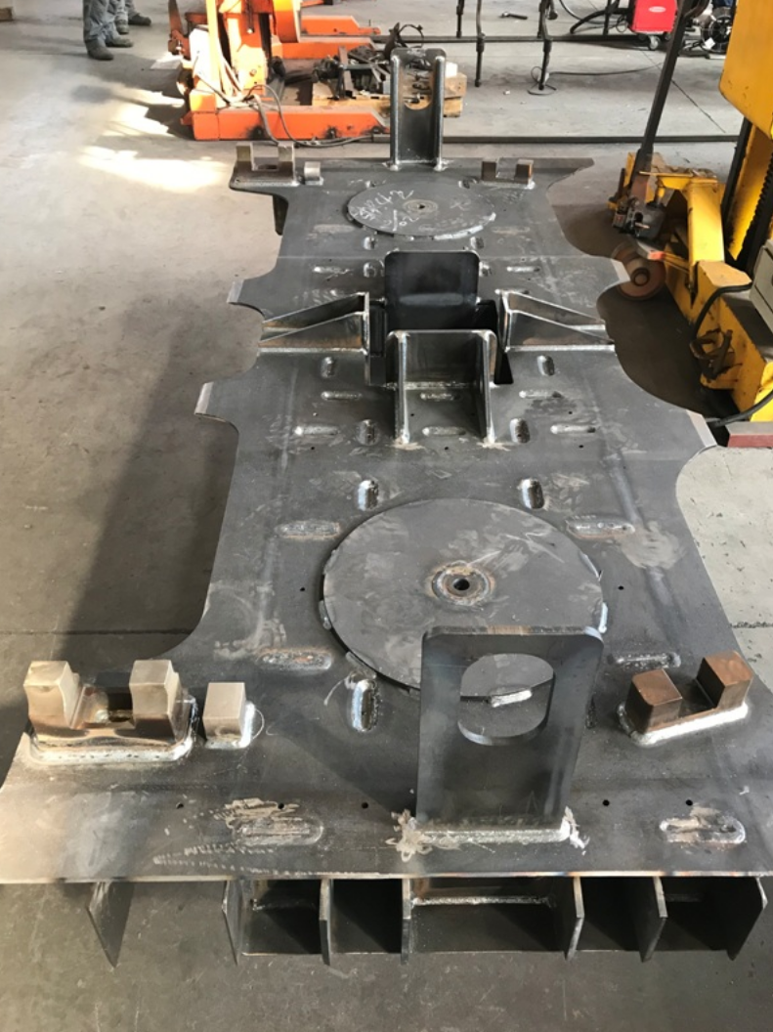
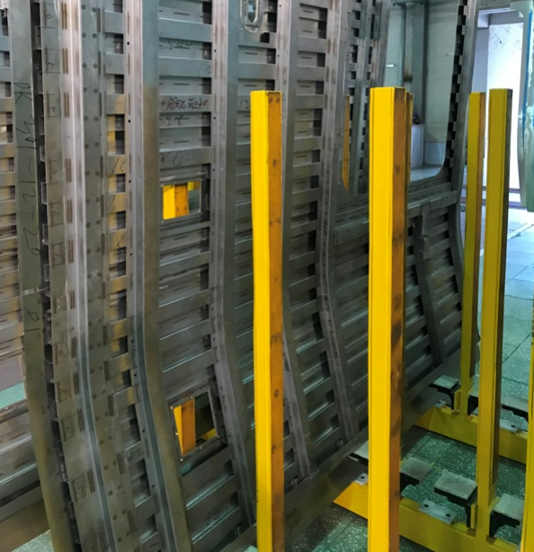
Red Line Vehicle Procurement Project Status
The Red Line pilot carshells are under construction in Changchun, China. The first Red Line carbody will be completed in November 2019.
Red Line Pilot Cars are schedule for delivery in the Spring of 2019.

Slide 10
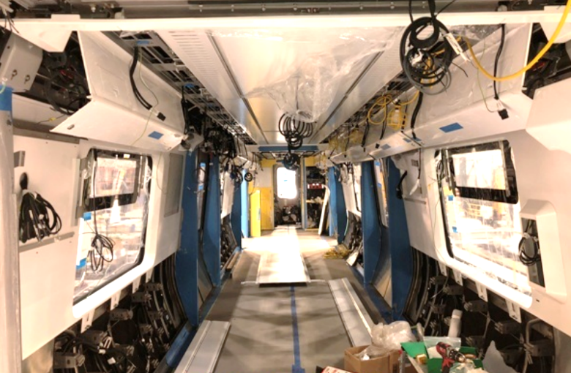
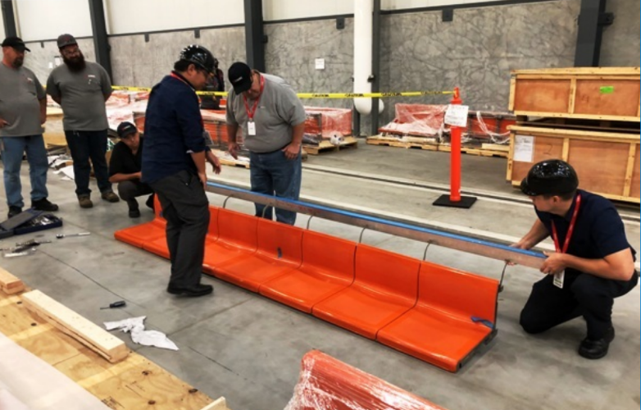
Production Vehicle Final Assembly – Springfield MA
Final assembly on the first four cars is continuing in Springfield with the installation of interior panels and wiring.
These first four (4) Orange Line cars are scheduled for delivery in December 2018.
There are currently 10 carbodies in the plant, with an additional 12 on the sea, having shipped from Changchun, China on September 23, 2018.

Slide 11
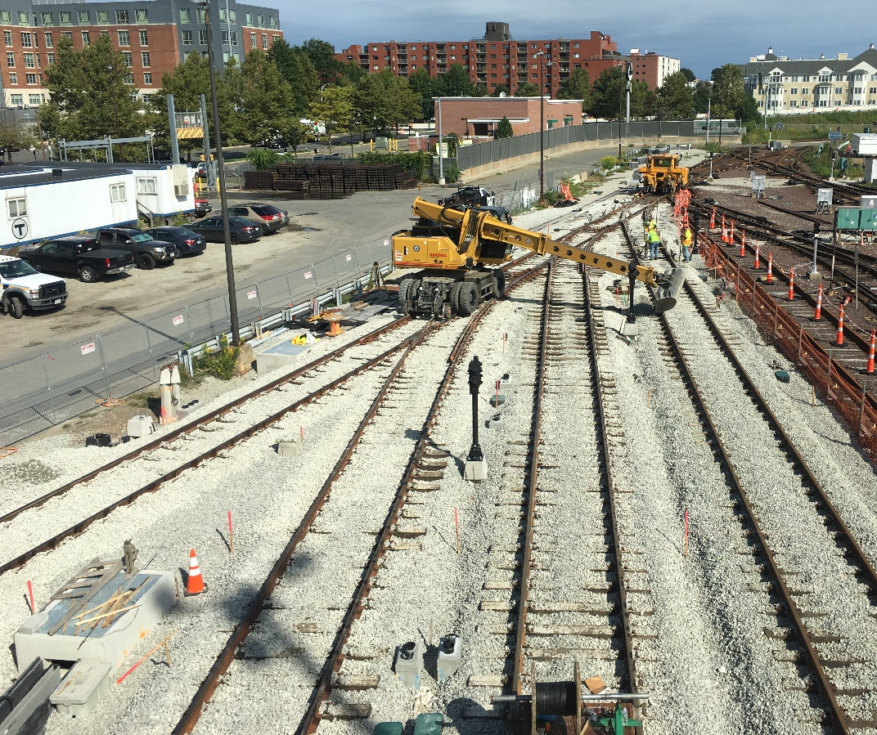
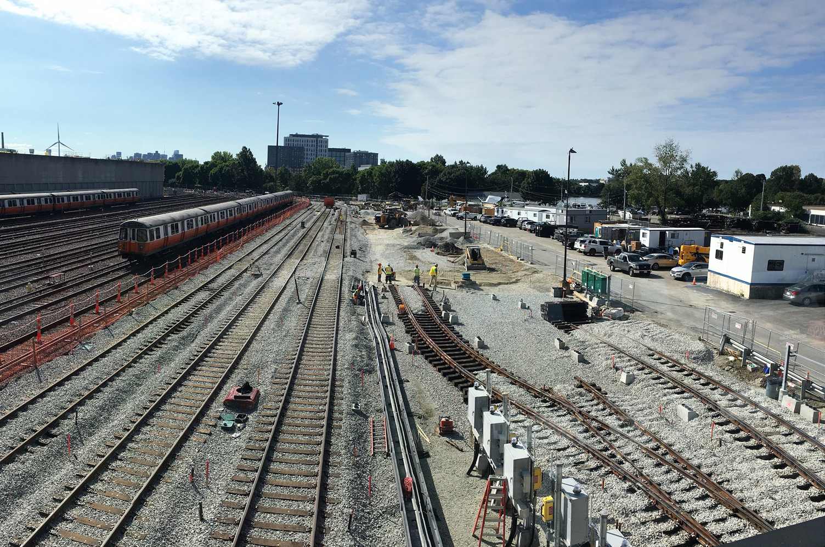
Orange Line Projects: Wellington Yard Expansion Tracks 33 to 38
JF White
Construction NTP: 12/05/2016
Construction Substantial Completion:
  Contractual: 06/23/18
  Projected: 01/04/19*
Construction Budget: $17,977,777
Construction Expenditures to Date: $6,863,589 Construction Percent Complete: 63%
*Adjusted to account for unforeseen environmental work
Installation of Ties, Track, and Ballast
Installation of Ties, Track, and Ballast

Slide 12
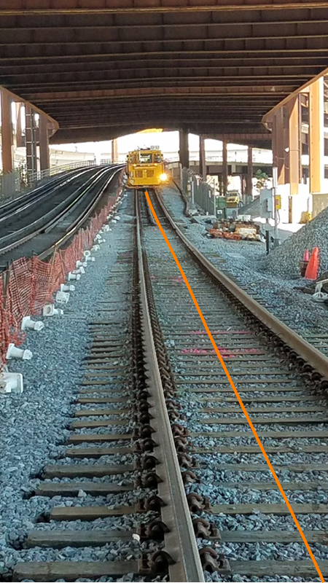
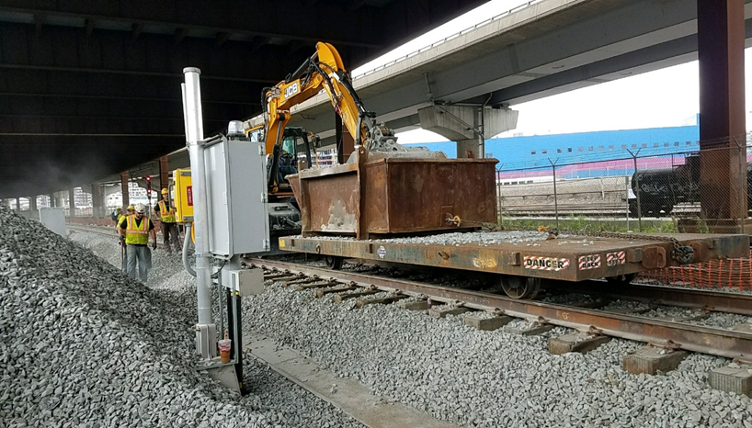
Orange Line Projects: Orange Line Test Track
LM Heavy
Construction NTP: 06/20/17
Construction Substantial Completion:8/29/18
  Contractual: 09/11/18
  Actual: 08/29/18
Construction Budget: $5,867,000
Construction Expenditures to Date: $3,939,146
Construction Percent Complete: 99%
Surface and Aligning Track
Placing Ballast

Slide 13
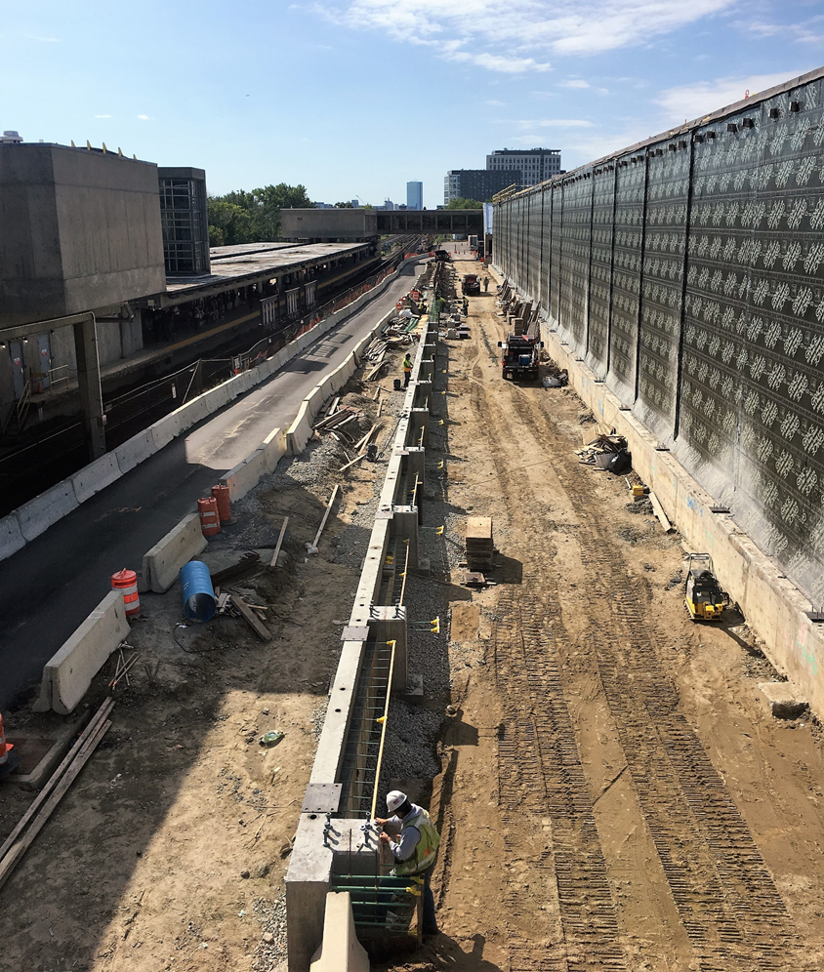
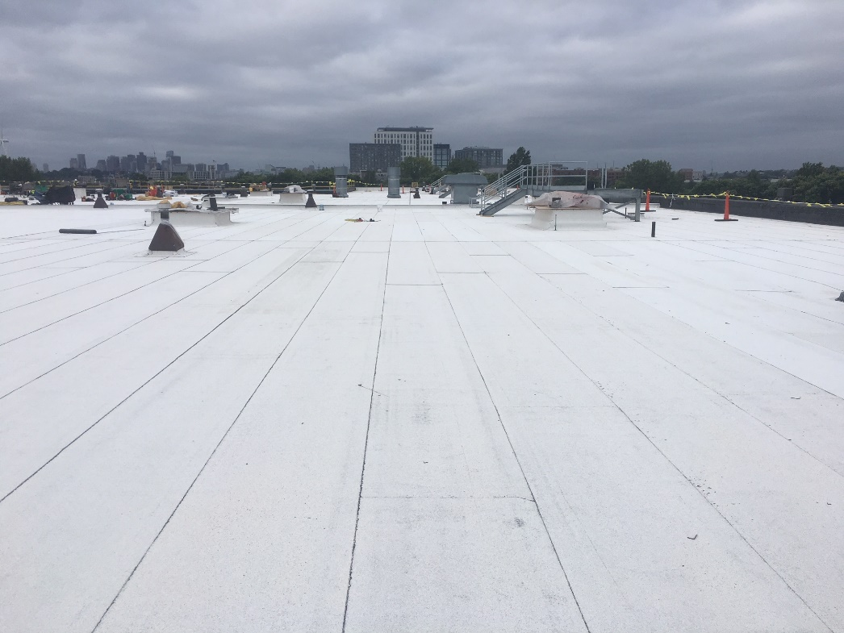
Orange Line Projects: Wellington Maintenance Facility
Barletta Heavy Division
Construction NTP: 06/30/17
Construction Substantial Completion:
  Contractual: 08/04/20
  Projected: 08/04/20
Construction Budget: $72,582,000
Construction Expenditures to Date: $17,283,335
Construction Percent Complete: 31%
* Forecast completing on schedule
Facility Expansion Grade Beam
Roof

Slide 14
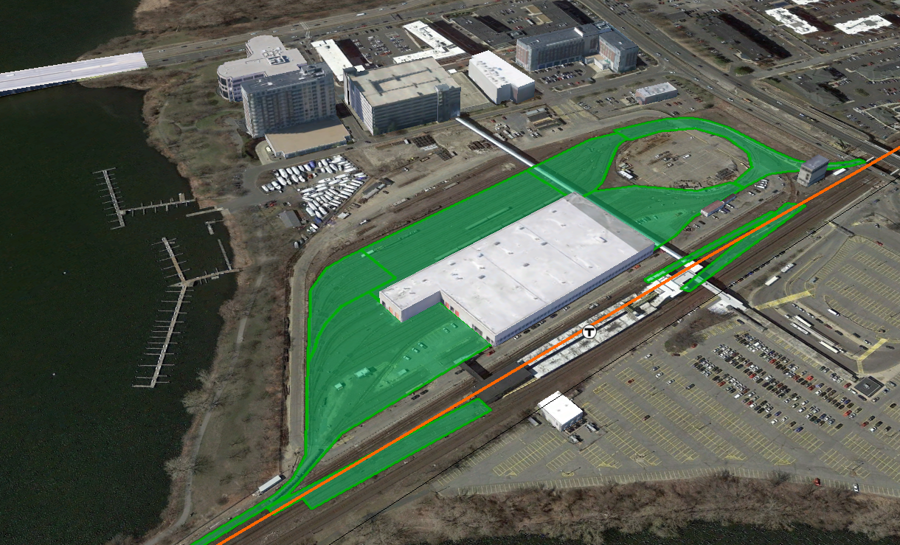
Orange Line Projects: Wellington Yard Rebuild
Barletta Heavy Division
Construction NTP: 05/31/18
Construction Substantial Completion:
  Contractual: 03/07/21
  Projected: 03/07/21
Construction Budget: $102,663,000
Construction Expenditures to Date: $0
Construction Percent Complete: 2%
  Wellington Yard Rebuild

Slide 15
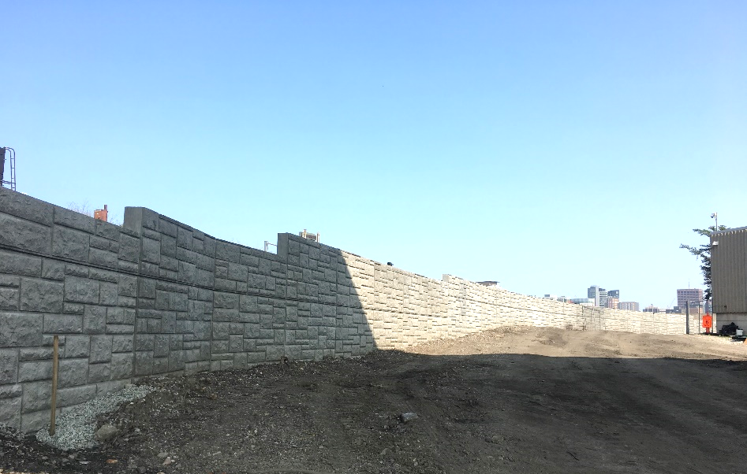
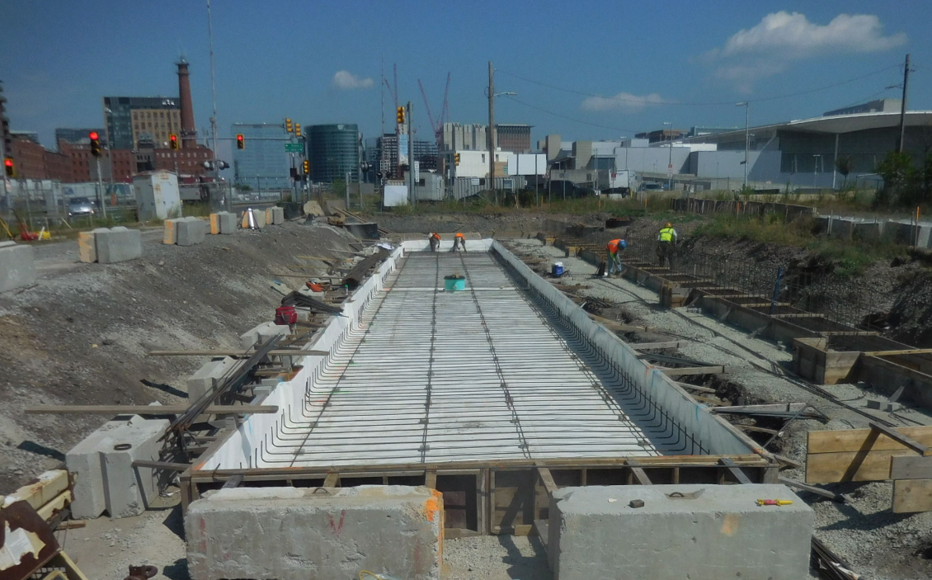
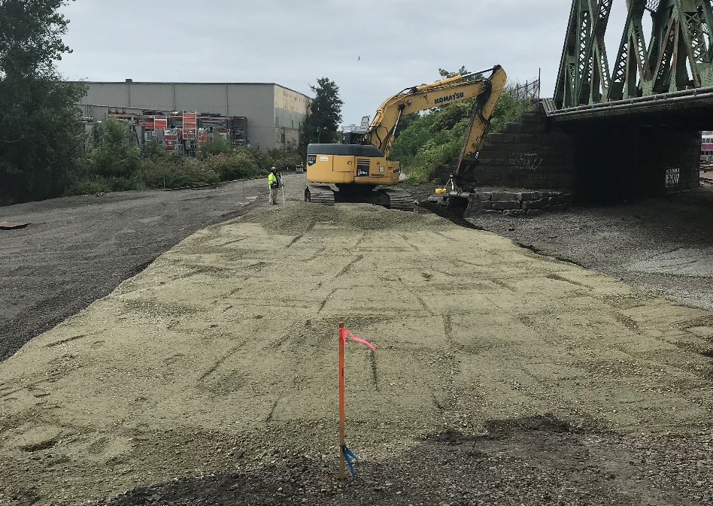
Red Line Projects: Red Line Test Track
Barletta Heavy Division
Construction NTP: 11/17/17
Construction Substantial Completion:
  Contractual: 04/07/19
  Projected: 04/07/19
Construction Budget: $21,269,000
Construction Expenditures to Date: $432,705
Construction Percent Complete: 30%
Retaining Wall
VTF Foundation & ReBar
New Sub Ballast for new lead Track From Cabot Yard

Slide 16
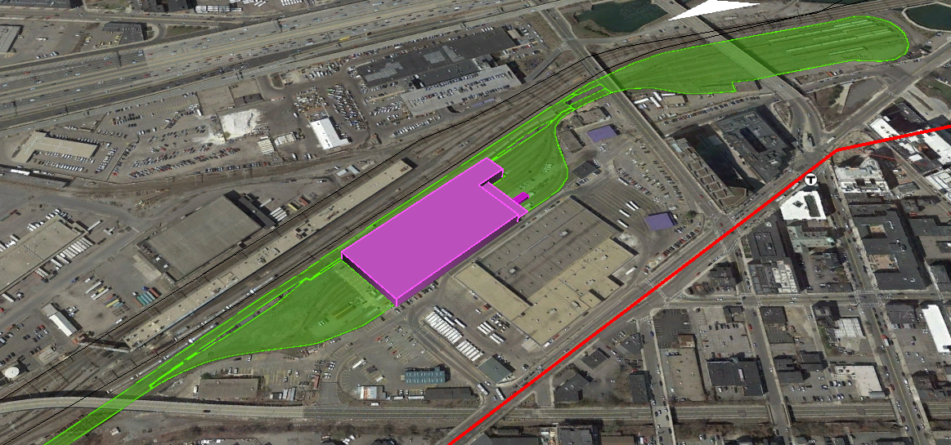
Red Line Projects: Cabot Yard & Maintenance Facility Improvements
LM Heavy/Lane Construction
Construction NTP: 08/02/18
Construction Substantial Completion:
  Contractual: 1/4/22
  Projected: 1/4/22
Construction Budget: $213,817,000
Construction Expenditures to Date: $0 Construction Percent Complete: 0%
  Cabot Yard & Maintenance Facility Improvements

Slide 17
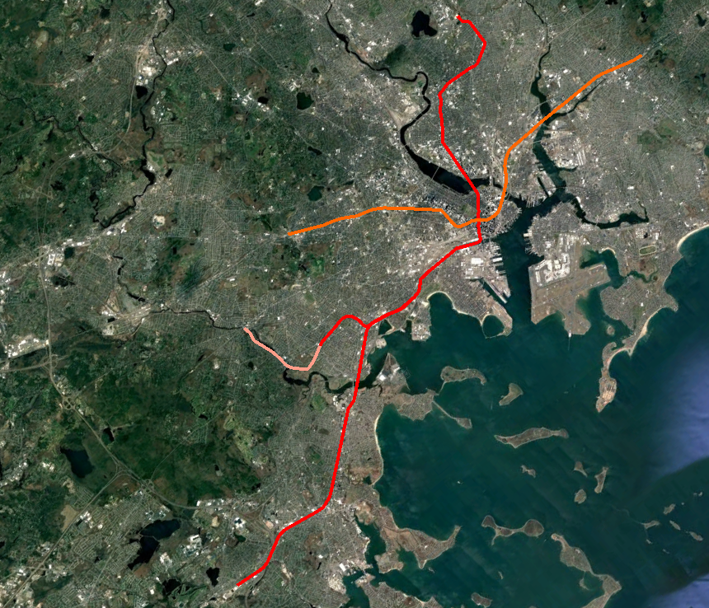
Signals Upgrade Projects Status
RFP Issued – 02/12/18
Proposer Meetings – 05/30/18
Proposals Due – 08/20/18
Public Price Opening – 9/20/18
NOA – October 2018
NTP – October 2018
Substantial Completion RL – December 2021
Substantial Completion OL – April 2022
Red Line
RL Signaling and Train Control System Upgrade
RL Columbia Junction Phase II
Orange Line
OL Signaling and Train Control System Upgrade
OL South West Corridor Wayside Signal Replacement

Slide 18
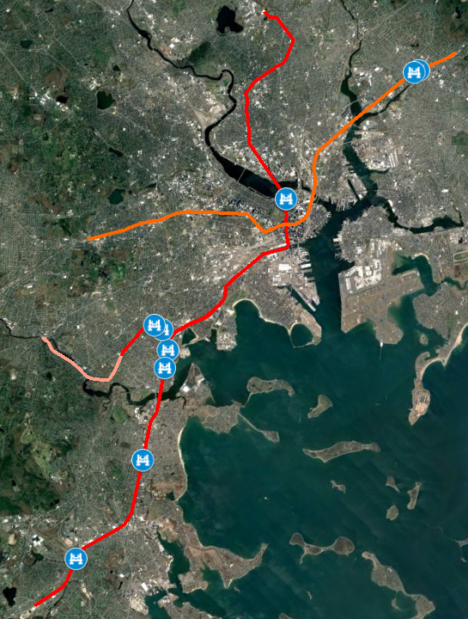
State of Good Repair Projects Status – Bridge Strengthening
Status
Bridge Repairs
RL Substantial Completion – 11/01/18
OL Substantial Completion – 11/30/18
Long Fellow Approach – Interim Repairs
Substantial Completion – 12/31/18
Red Line
Bridge Repairs
Granite Spur-B-21-069 (A23)
Conley St.-B-16-136 (A38)
Fields Corner Busway-B-16-418 (A3N)
Victory Rd -B-16-134 (A36)
Geneva Ave-B-16-142 (A3D)
Long Fellow Approach - Interim Repairs
Orange Line
Bridge Repairs
Charles Street-M-01-003 (85)
Adams Street-M-01-002 (85J)

Slide 19
Vehicle Procurement & Improvement Program Collaboration
Accompanied vehicle procurement program on foam block clearance test to indicate potential clearance interfaces and collect additional data as needed.
Coordinated arrival of 4 Pilot Cars delivery at the end of August.
Update of vehicle storage models to analyze storage impacts due to latest contractor schedule.
Vehicle/Infrastructure scope coordination (ATO, reinforcement of pits, etc.)

