Slide 1
General Manager’s Remarks
Fiscal and Management Control Board
October 1, 2018

Slide 2
Agenda
“45th bus:” first extended-range hybrid
Town hall kickoff meeting at Orient Heights
2018 Roadeo
Capital investments

Slide 3
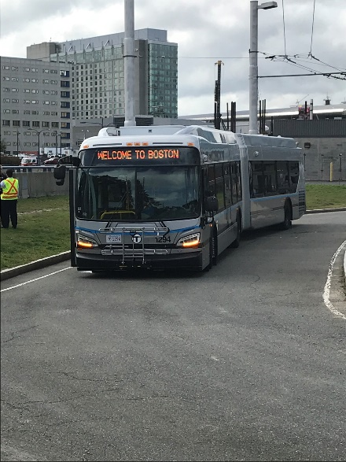
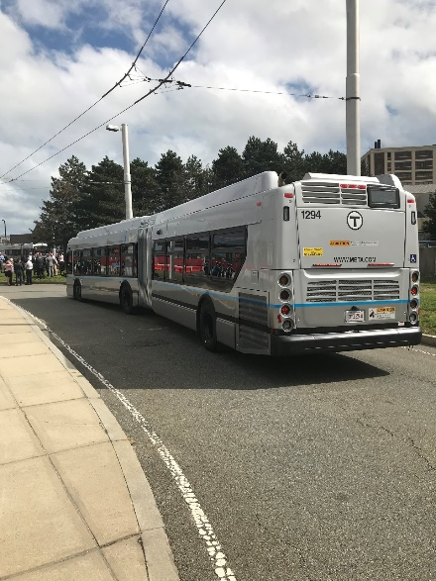
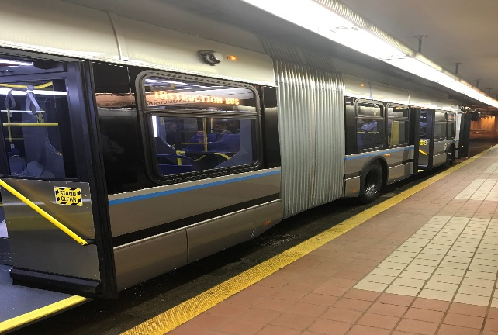
“45th bus:” first extended-range hybrid arrives
New extended-range vehicle arrived for testing
Planning for the future: could save on transitway OCS maintenance, reduce greenhouse gases, improve reliability
Technology/industry continues to evolve
Bus will operate on a test basis; look forward to learning more
45th bus is part of New Flyer contract for 44 60-foot diesel-electric buses; option for 45th extended-range bus

Slide 4
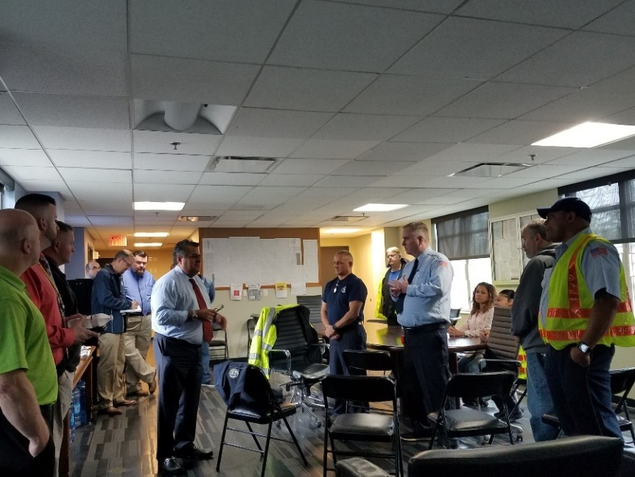
Town hall meeting series kickoff: Orient Heights
First in a year-long series to engage in a two-way conversation between employees and MBTA leadership
Attendees represented wide range of departments/disciplines from the Blue Line
Looking forward to finalizing the list of future meetings, and enhancing employee engagement and improving customer service

Slide 5
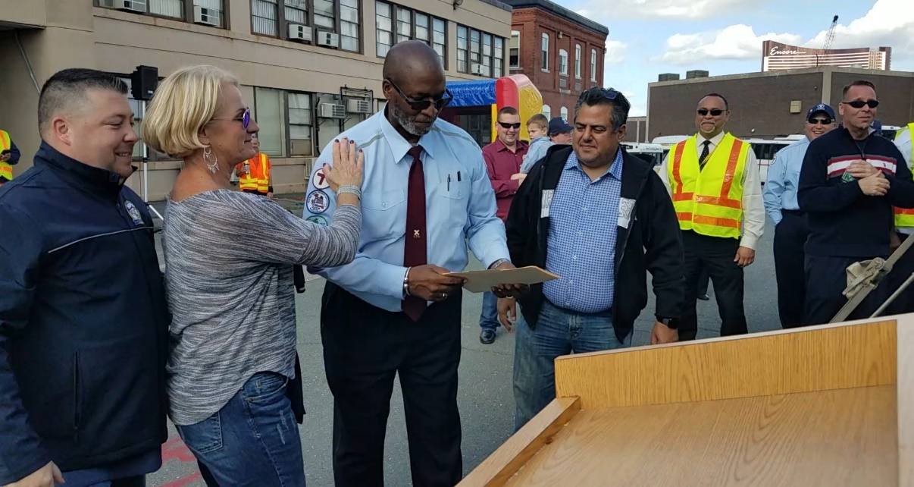
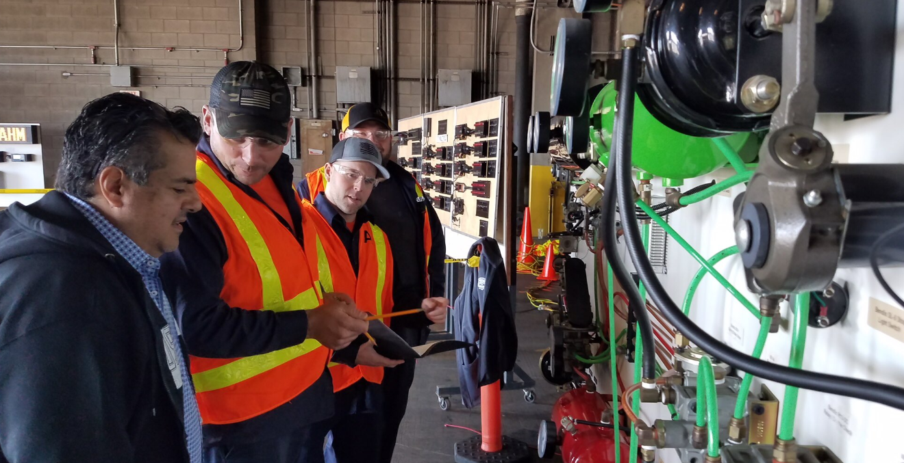
2018 Bus ‘Roadeo’ - Charlestown
Annual “Roadeo” event for Machinists and Bus Operators
Devotion to jobs, trades, and mission on full display
Congratulations to all involved – especially Willis Rose, five time Bus Operator champion

Slide 6
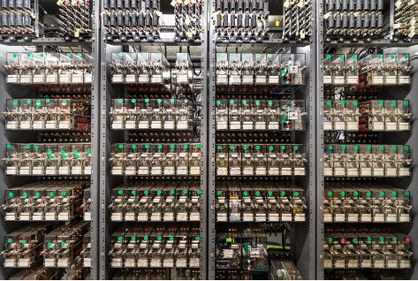
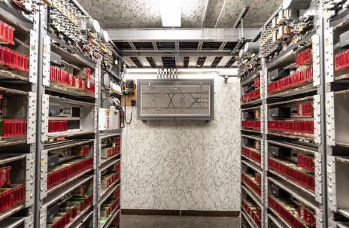
Capital investments
Momentum of capital investments continues
CIP tied to programs and targets; strong documentation and review requirements for change orders
Major programs continue to advance: R/O Line signals last of the major contracts for R/O Infrastructure Program
Significant milestone for our ability to make investments and will result in major customer-facing improvements

