Slide 1
DGM Remarks
Fiscal & Management Control Board
October 1, 2018

Slide 2
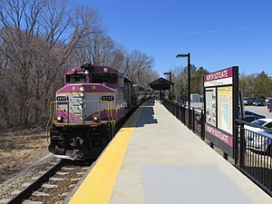
DGM Remarks 10/1/18
Old Colony Incident – September 25, 2018
Train 083 (4:52 PM outbound to Greenbush) disabled at Quincy Center (single track)
Disabled train required coupling with another train.
Extensive delays due to this incident
Communication to the customer raised as an issue

Slide 3
Green Line D Track and Signal Replacement Project
DGM Remarks 10/1/18
SCOPE
Between Beaconsfield and Riverside stations
Replace 25,000 ft of track
Replace 6.5 mi of signal infrastructure
SCHEDULE
Construction starts October 8th
Duration Oct 2018 – Dec 2020
Evening/Weekend Work
Scheduled work is dependent on weather
COORDINATION with concurrent work
The Fenway Portal Flood Protection Project
Ongoing Maintenance Work (between Beaconsfield and Kenmore Stations)

Slide 4
Green Line D Track and Signal Replacement Project
DGM Remarks 10/1/18
BENEFITS
Bring Track and signal to a State of Good Repair
Improve reliability and reduce delays
Eliminates existing speed restrictions
Overnight and weekend work
reduces the construction schedule minimizing disruption
Overnight and weekend work reduces cost and saves taxpayers money

Slide 5
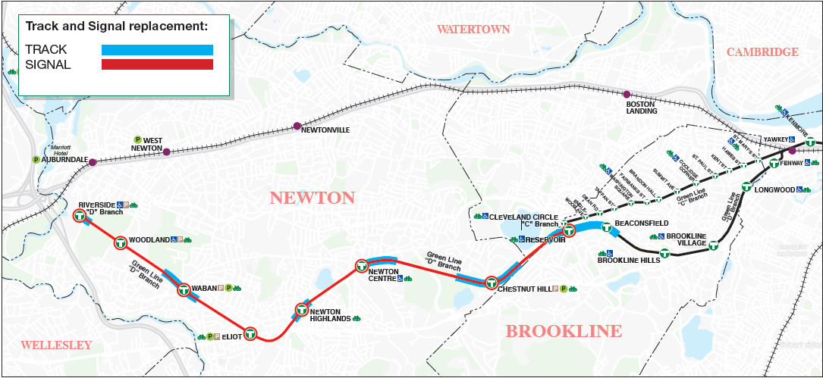
Bus Diversions By Zone
Green Line Transformation
Weeknights (9:00 pm to end of service) and Weekends (bus service will replace regular service during weekend diversions)
ZONE 2
ZONE 1
ZONE 3

Slide 6
Operations During Construction
Green Line Transformation
Green Line D Branch will provide regular service except as noted below.
Sunday through Thursday certain sections of the Green Line will be closed between 9:00 pm and close of regular service except as noted below* (one zone at a time) (actual start date dependent on the contractor’s schedule)
- 2018
- October 8 – October 18: Reservoir – Brookline Hills (Zone 3)
- October 21 – December 28: Reservoir – Kenmore (Zone 3)
- 2019 and 2020
- April 9 to Dec. 28: (Zones To Be Determined)
Planned weekend diversions on the D Branch:
- 2018: Utilizing 3-5 weekends in November/December (Zones To Be Determined)
- 2019-2020: 14 weekends of service outages (9 pm Friday to 5 am Monday)
- 2019 or 2020: 1 long weekend of service outage (9 pm Friday to 5 am Tuesday)
Bus service will replace regular service during weeknight and weekend diversions
- Planned headways are 8 minutes
- Customers should anticipate their trip being up to 15 minutes longer
*During Red Sox home games, special events and holidays, Sunday through Thursday evening service will end at 11 pm (except in 2018 when regular service will run during Red Sox home games

Slide 7
Communications Plan - Construction
DGM Remarks 10/1/18
Public Briefings and Meetings
Newton and Brookline select board briefings held
Two public meetings
Periodic project briefings upcoming
Project Website
Regular construction updates
Copies of presentations
Listing of upcoming meetings
Email sign-up
Email Advisories
Regular construction updates
Media Advisories
Issue periodic media advisories to promote the project and advise the public of the ongoing work
Coordination with City of Newton and Town of Brookline
Weekly construction updates
Quarterly reports to each
In-Person Notifications
Distribute flyers about work as it progresses (abutters, adjacent businesses, Green Line Station Platforms)

Slide 8
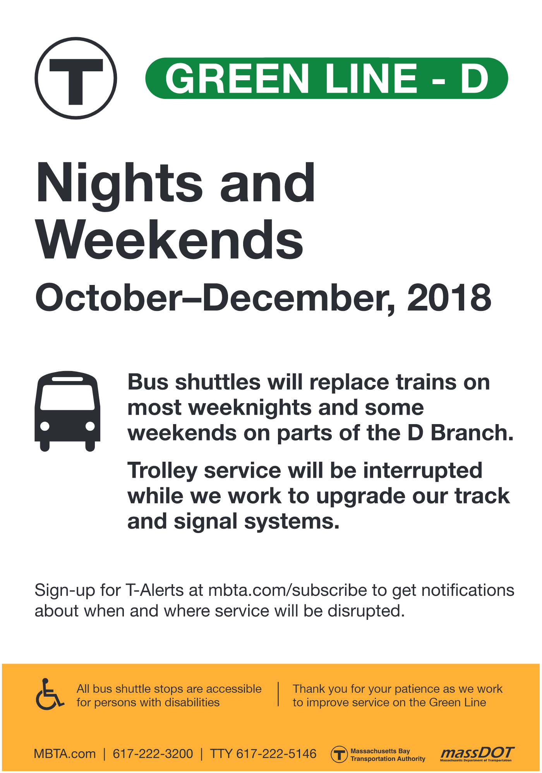
Communications Plan – Service Disruptions
DGM Remarks 10/1/18
General notification
Signs in stations advising customers to sign up for T-Alerts (pictured right)
Project webpage www.mbta.com/GreenLineD
Service outages
T-Alerts (web, apps, text/email)
Advisories in stations
Online trip planners will show shuttle service
Station announcements
Onboard announcements
Temporary wayfinding to/from shuttles

Slide 9
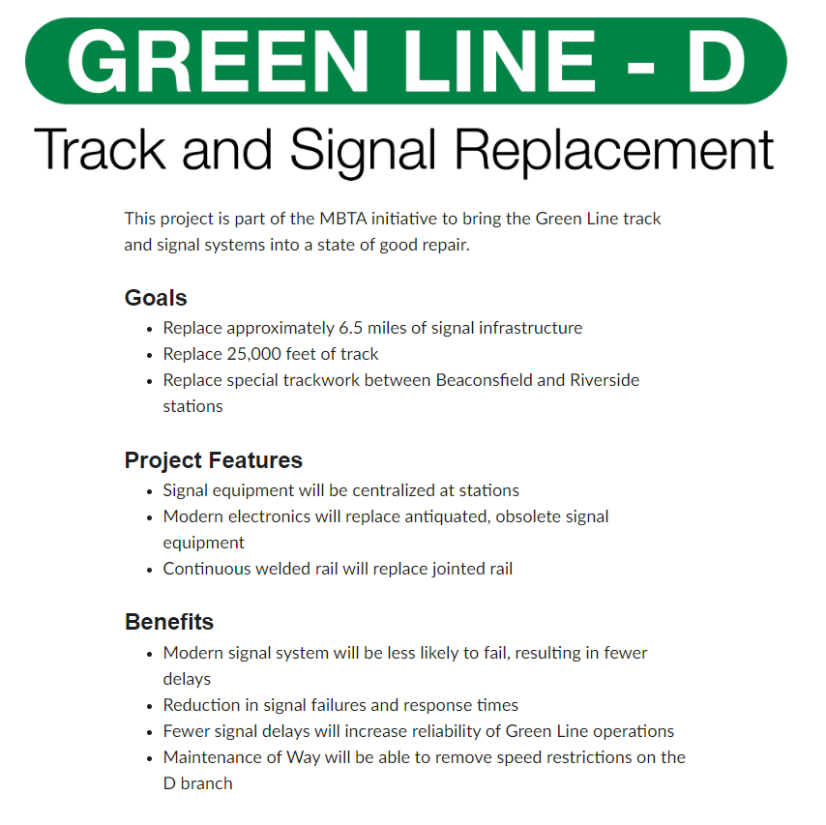
Communications Plan – Project Benefits
DGM Remarks 10/1/18
Project webpage
Notes project benefits
Will be updated as project progresses
Digital screens
#RebuildingTheT video will be created
Twitter thread
Detailing the work, why it’s necessary, and what the benefits will be

