Slide 1
Contract No. 679: New Flyer 194 40-foot Advanced Hybrid Option Order
October 1, 2018

Slide 2
Overview
Contract No. 679: New Flyer 194 40-foot Advanced Hybrid Option Order
MBTA continues to invest in new vehicle procurements to replace aging fleets with more efficient and reliable vehicles.
Today’s presentation defines the overall program and approach for procuring an Option fleet of 194 new 40-foot low floor advanced diesel-electric hybrid buses from New Flyer:
Work will be performed in accordance with existing Contract No. 679 and Technical Specification VE14-041
Delivery of the 194 advanced hybrid buses is anticipated to begin in June 2019 and be completed by the end of September 2020
Bus Fleet Age:
Target: 7.5 years
Current: 7.3 years
After Delivery (2020): 6.8 years

Slide 3
Contract No. 679: New Flyer 194 40-foot Advanced Hybrid Option Order
Background
New Bus Procurement Contract No. 679 with New Flyer Industries was executed on September 28, 2015 for 325 40-foot buses of mixed propulsion technology to replace the aging CNG NABI fleet:
150 diesel-electric hybrid buses
175 CNG buses
All buses were delivered on time and were in operation by September 2017
Contract No. 679 includes options for additional vehicles:
200 advanced diesel-electric hybrid buses
6 option buses have been exercised – (Winthrop buses)
200 diesel-only buses
In line with the Authority’s fleet plan Vehicle Engineering requesting to exercise the remaining contract options for 194 Advanced Hybrid buses replacing the oldest diesel buses.

Slide 4
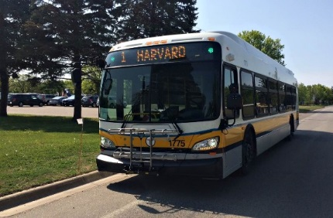
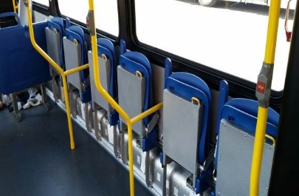
Purpose - New Flyer 40-foot Advanced Hybrid Bus
Contract No. 679: New Flyer 194 40-foot Advanced Hybrid Option Order
Replace the aging 193 Neoplan diesel bus fleet purchased in 2004
Enhanced passenger flow and ADA accommodations
Improve fleet reliability with a modern, efficient, and proven vehicle / propulsion design
This advanced hybrid fleet is expected to reduce environmental impacts over the life of the vehicle, as compared to traditional diesel vehicles:
Fuel consumption reduced by 2.8 million gallons
Greenhouse gas (GHG) emissions reduced by 41,000 tons
Nitrogen oxide (NOx) emissions reduced by 28,000 tons
Fleet idle time reduced by 900,000 hours

Slide 5
New Flyer 40-foot Hybrid Bus – Features
Contract No. 679: New Flyer 194 40-foot Advanced Hybrid Option Order
The 194-bus option will be nearly identical to the vehicles received on the base order with an upgrade to the Cummins Engine and the BAE Energy Storage System (ESS).
ESS upgrade:
Increased storage capacity by 66% to improve performance and engine-off operation
Next generation battery package meets new federally mandated On-Board Diagnostics (OBD) and EPA Green House Gas (GHG) emissions requirements
8-year life expectancy & high reliability supporting zero-emission driving
Up to 35% EV drive miles
Design features:
Driver’s barrier
Battery management system
Flip-up seating configuration preferred by the ADA community
All base order fleet design changes and upgrades will be incorporated

Slide 6
Engineering Professional Services Contract Update
Contract No. 679: New Flyer 194 40-foot Advanced Hybrid Option Order
MBTA Vehicle Engineering is in process of selecting a firm for Engineering and Program Management Professional Services for the procurement of new transit buses through MBTA Contract No. V51PS02.
The Professional Services Team will support the proposed procurement with:
Design review
Systems engineering and integration
In-plant inspections and quality assurance
Vehicle acceptance, testing, and commissioning
Overall program management and engineering support
Upcoming Board presentation recommending award is expected November 2018.

Slide 7
Project Timeline
Contract No. 679: New Flyer 194 40-foot Advanced Hybrid Option Order
Board Award New Flyer 194 40-foot Hybrid Option……………….…Today
Board Award Professional Services Contract…………….…………..Nov 2018
194 Option Vehicle Design Review Activities…………………………Dec 2018
194 Option Vehicle Deliveries Begins……………………………........June 2019
194 Option Vehicle Deliveries Concludes……………………….…….Sept 2020

Slide 8
Request of the Fiscal Management and Control Board
Contract No. 679: New Flyer 194 40-foot Advanced Hybrid Option Order
Vehicle Engineering requests that the Fiscal and Management Control Board authorize the General Manager & CEO, or his designee, to award and execute an Option Order on existing Contract No. 679 to manufacture, furnish and deliver 194 new low floor advanced hybrid buses with spares, training, training aids, specials tools, publications and communications for a total delivered amount not to exceed $150,163,886.

