Slide 1
General Manager’s Remarks
Fiscal and Management Control Board
May 7, 2018

Slide 2
Agenda
SL3-Chelsea ridership
Advertising update

Slide 3
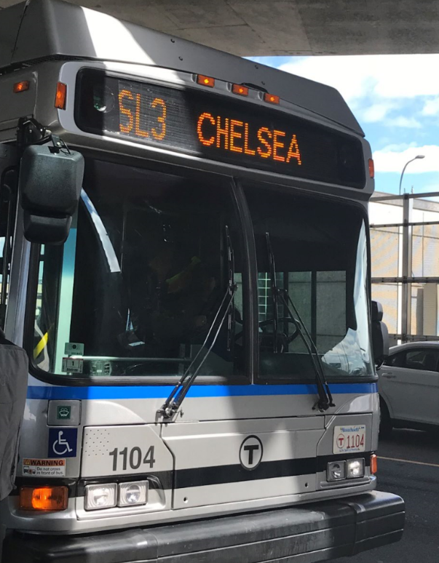
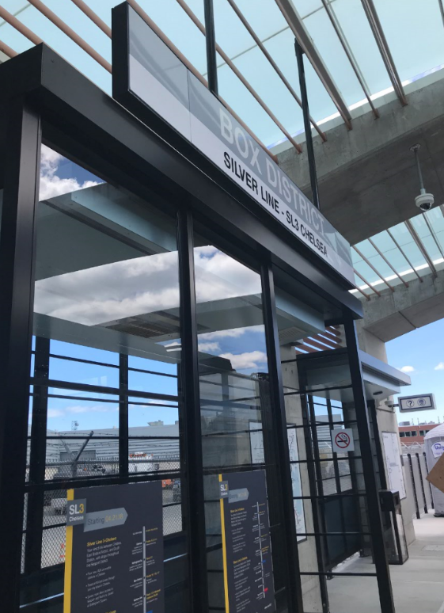
SL3-Chelsea – Ridership: April 21-April 27
Saturday (opening day), April 21: 2,950
Sunday: 1,950
Weekday average: 4,400
Weekday average consists of all stops from South Station to Chelsea.
30 percent of weekday boardings (1,300/day) are at new SL stations: Chelsea, Bellingham Square, Box District, Eastern Ave, and Airport
Estimates are based on ridership from first week of service. Data quality will improve as data collection increases.

Slide 4
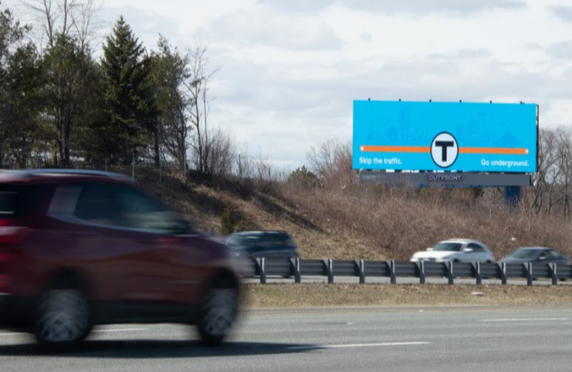
Advertising update
MBTA’s core objectives based on two principles:
Character and extent of facilities must be built to provide regional transportation services
T must take “all necessary steps” to raise non-fare revenue before implementing fare increases

Slide 5
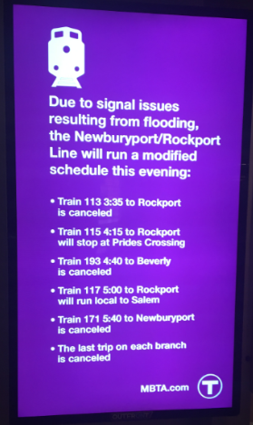
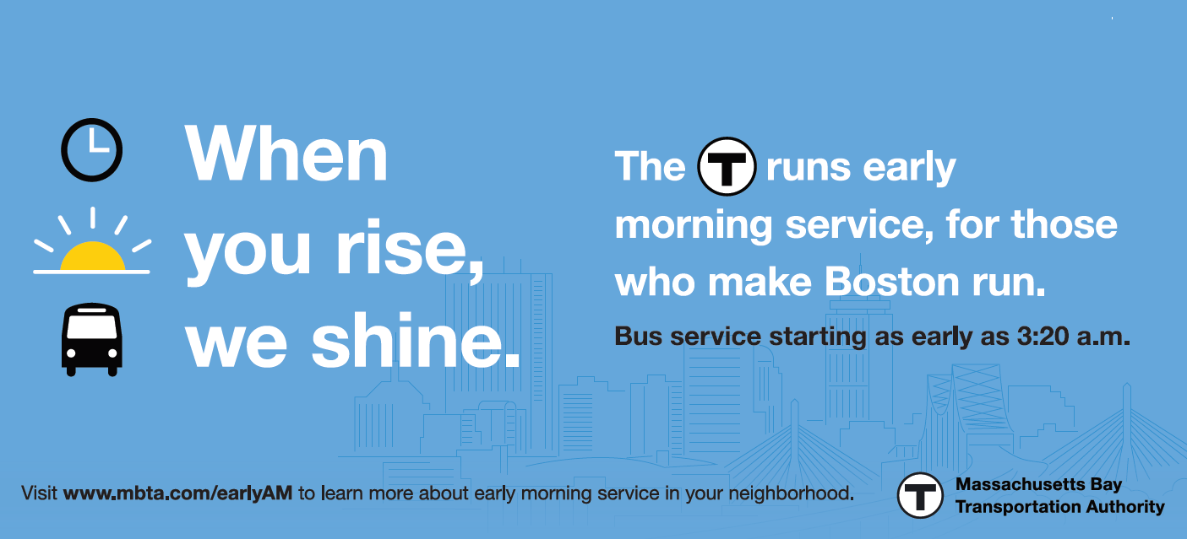
Advertising update
New uses for advertising assets: platform for customer communications
Vastly improved technology can better meet customer information needs
Major shift from legacy static billboards: over past 20 years, inventory has decreased by more than 50 percent

Slide 6
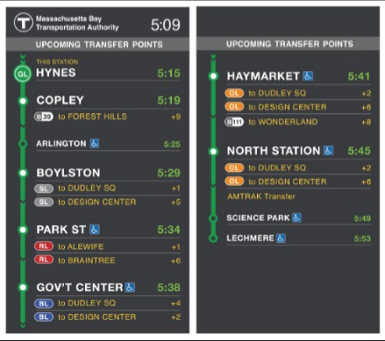
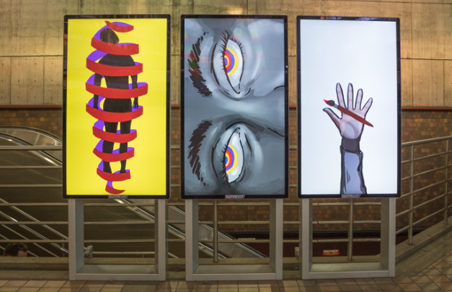
Advertising update
Advertising assets are a reliable source of non-fare revenue: approximately $30 million annually
Keeps costs down for our customers
New technology provides added customer value as an enhanced channel for communications for:
Real-time information
New services: early AM, SL3
Weather-related messages
Public art

