Slide 1
DGM Remarks
Fiscal & Management Control Board
May 7, 2018

Slide 2
Better Bus Project Update
Project Schedule
Results/Resource analysis
Implementation of Recommendations
Dec. 2018
Discussions with MBTA bus operators and staff
Feb.–Mar. 2018
June–July 2018
Finalization of Recommendations
Presentation to Board
Board to Vote on final recommendation
Implementation of Recommendations
Market Analysis
Route Profiles
Framework Evaluation
Meeting riders at bus stops
Public meetings/workshops
Municipal/Stakeholder Outreach
Implementation of Recommendations
Development of draft recommendations
Municipal/stakeholder outreach
Meeting riders at bus stops
Public meetings/workshops
Implementation of Recommendations
Implementation of Recommendations
July–Nov. 2018
Jan. – Apr. 2019
Apr.–May 2018
Notes:
Yellow – public engagement element
Comment by Jess Casey over Jan-Apr 2019 element: This needs to be revised -- when are people going to see the results? This is very policy/project management oriented

Slide 3
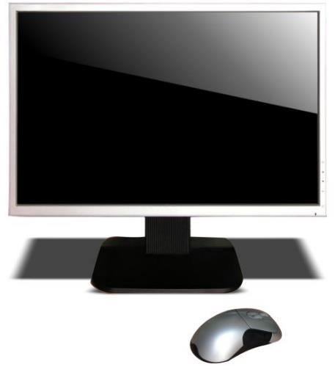
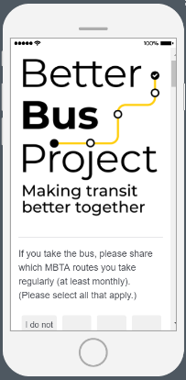
DGM Remarks 5/7/18
Better Bus Project Update
Collecting Feedback – Online and App
Website: www.mbta.com/betterbus
App

Slide 4
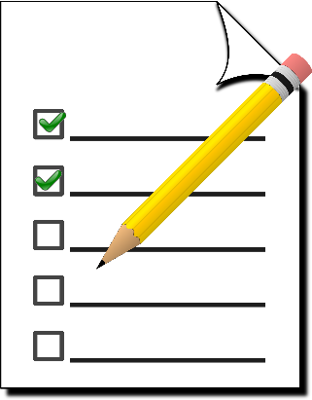
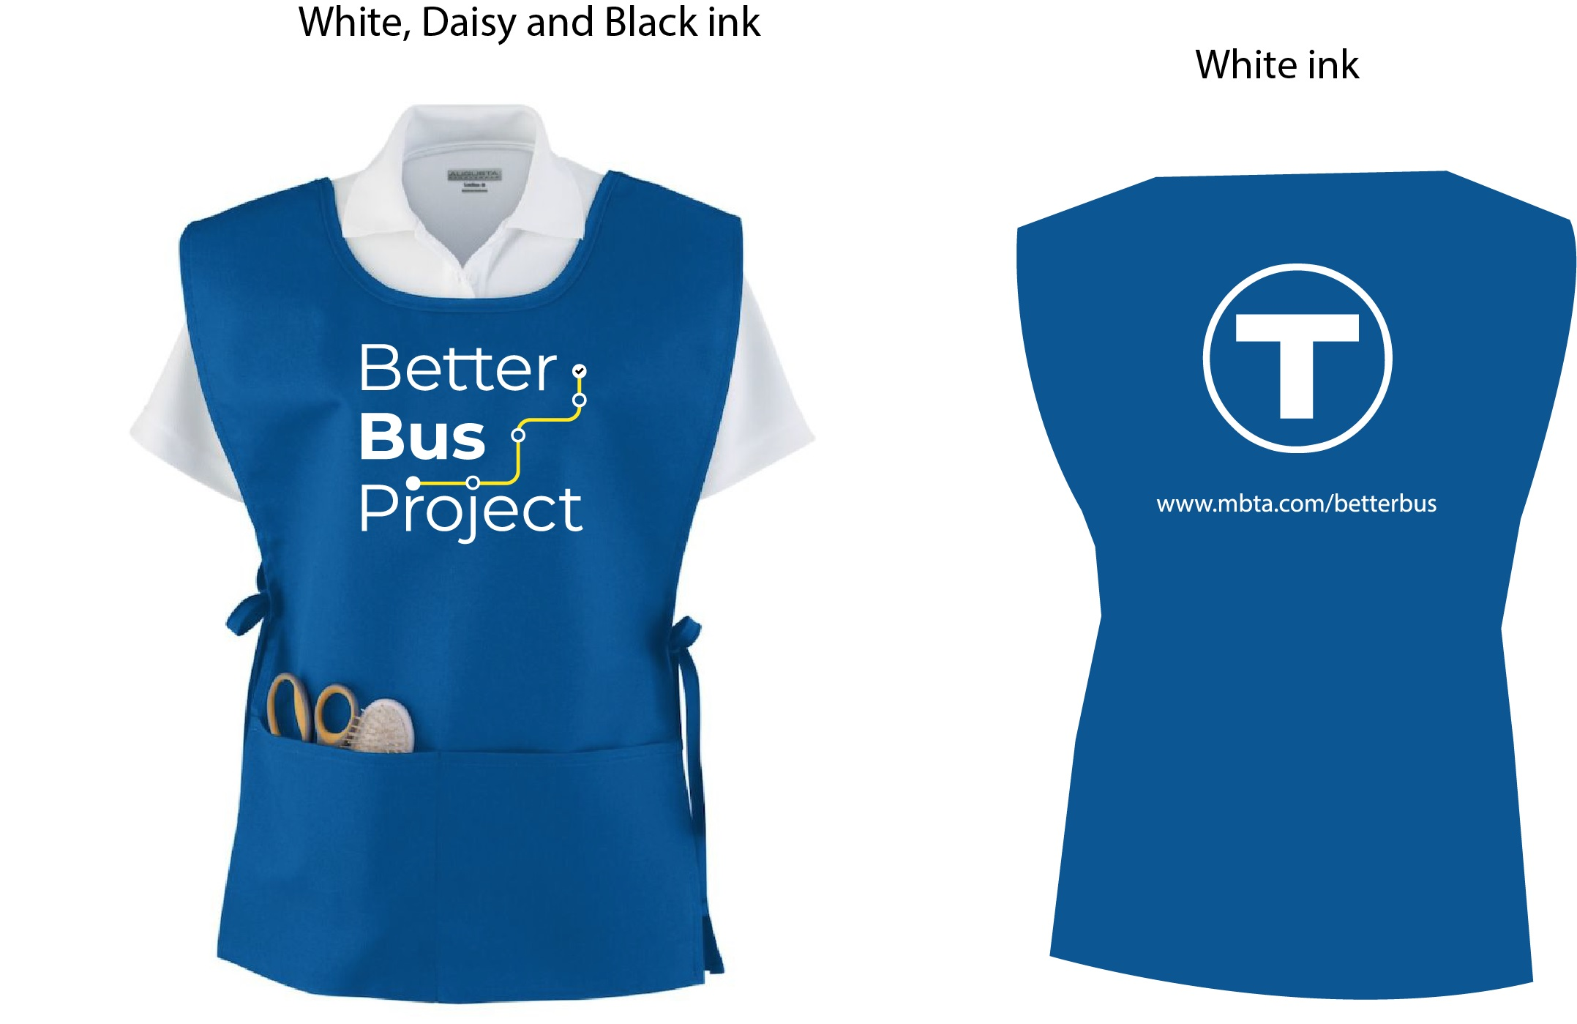
Collecting Feedback - Street Team Materials
DGM Remarks 5/7/18
Notes:
Postcard will be handed out (translated in 6 languages)
Staff will be wearing smocks to easily be identifiable
Will also be able to take feedback with survey cards

Slide 5
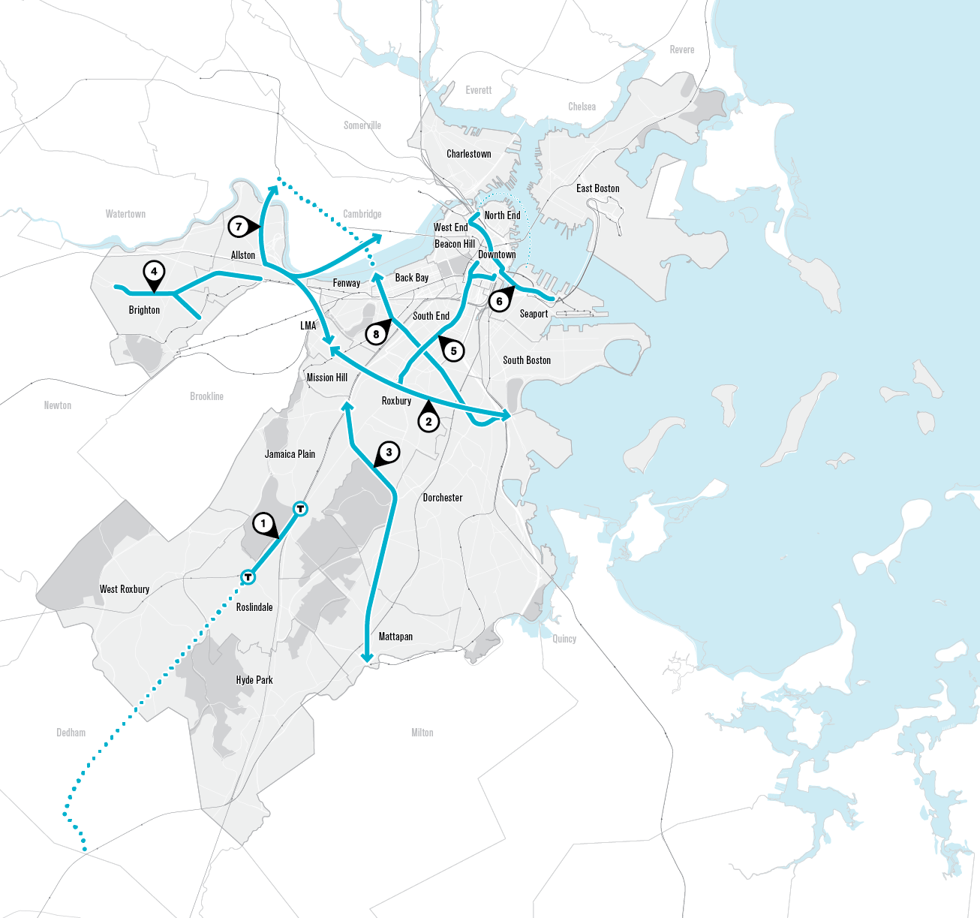
Boston Better Bus Working Group
Ongoing:
Forest Hills to Roslindale Square
Silver Line Dudley
Next Generation:
Oak Square to Commonwealth Ave.
North Station to South Boston
Mattapan to LMA
Massachusetts Avenue
City of Boston Transit Team
Team Coordinator
Planner / Engineer
Field Staff – 4

Slide 6
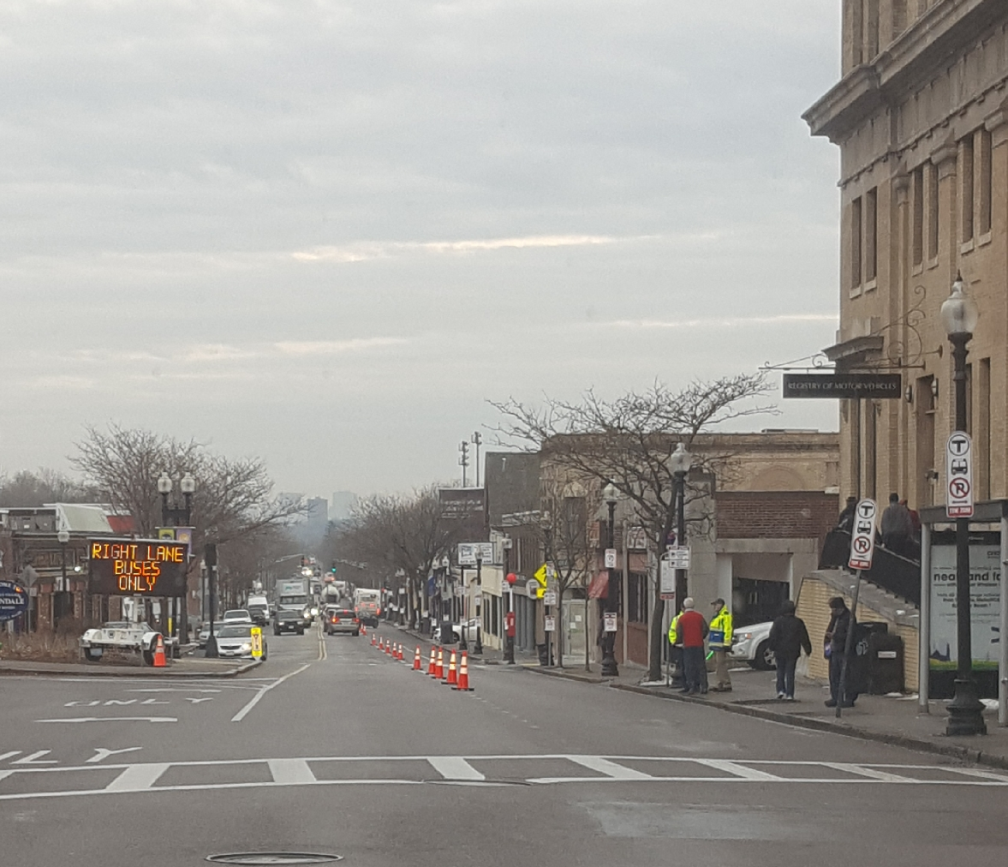
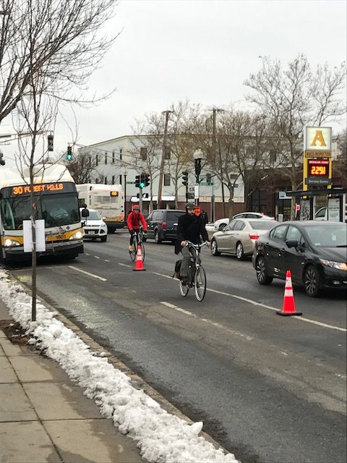
Roslindale – Forest Hills
Test: December 12th and 19th
Pilot: Four weeks starting May 7th
Outreach two weeks in advance with VMS boards, flyers, and meetings with community groups and merchants
Cones and signs designate the parking lanes as an exclusive bus lane. Bikes share the lane with buses
BPD & BTD ensure no vehicles remain in the lane overnight and enforce lane during hours of operation
MBTA & BPS Bus Ops have drivers informed and ready to go
Performance measures for bus and general traffic travel time and reliability, customer survey

Slide 7
DGM Remarks
Fiscal & Management Control Board
May 7, 2018

