Slide 1
MBTA Construction Contract No. S01CN03: Track/ROW II On-Call Construction Services, Systemwide
June 25, 2018

Slide 2
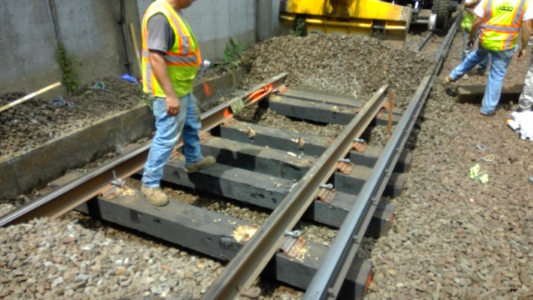
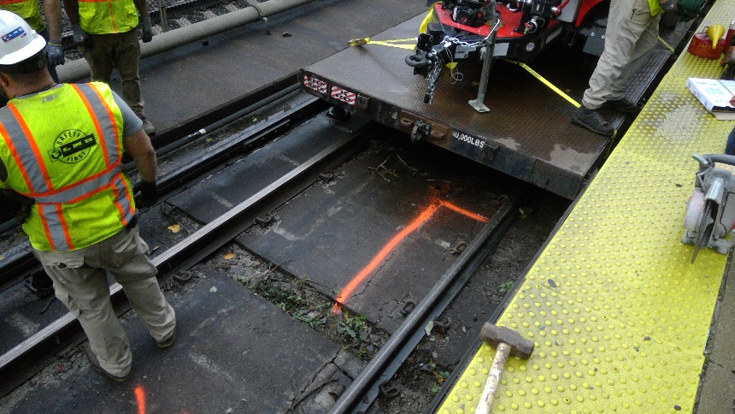
OVERVIEW
Contract S01CN03: On-Call Construction Services, Track/ROW II, Systemwide
Today’s Board action will provide for emergency, urgent and routine repairs and reconstruction of track and right-of-way elements on an on-call basis throughout the MBTA rapid transit system.
Track and right-of-way improvements will address state of good repair needs, enhance safety and improve system reliability and customer satisfaction.

Slide 3
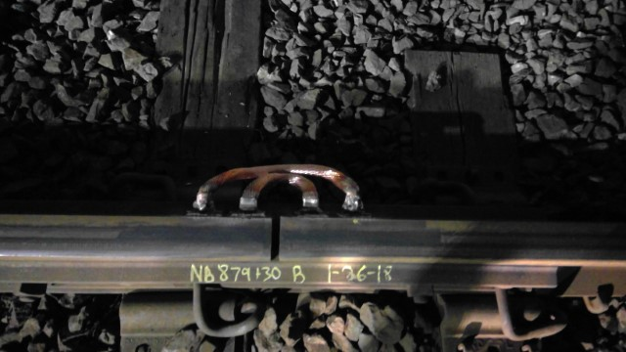
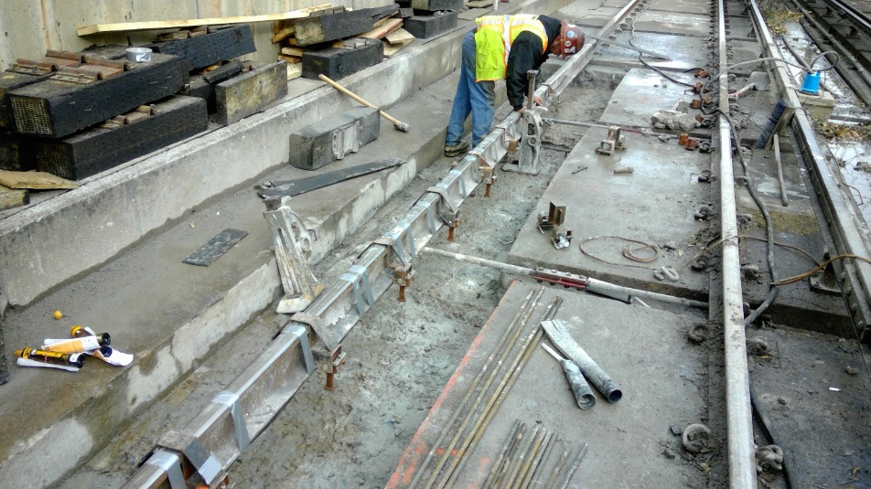
Construction Scope
Contract S01CN03: On-Call Construction Services, Track/ROW II, Systemwide
Work will be assigned on a project by project basis, as directed by the Authority, and will utilize bid items and contractor unit prices.
Work to be performed includes:
Spot Tie Replacement
Spot Rail Replacement (Heavy and Light Rail)
Direct Fixation Track Repair
Track Joining by Butt and Thermite Welding

Slide 4
Construction Advertisement and Bid
Contract S01CN03: On-Call Construction Services, Track/ROW II, Systemwide
Project was advertised on May 24, 2018
Engineer’s Estimate is $27,586,504.62
Bid Opening was on June 21, 2018
Three (3) Bids were received
$28,734,366 The Middlesex Corp. (Low Bidder)
$28,867,256 J.F. White Contracting Co.
$33,467,467 Lm Heavy Civil Construction, Llc
Bid analysis has been completed

Slide 5
Request of the Fiscal and Management Control Board
Contract S01CN03: On-Call Construction Services, Track/ROW II, Systemwide
Staff request that the Fiscal and Management Control Board authorize the MBTA General Manager and CEO, or his designee, to award and execute MBTA Construction Contract No. S01CN03: Track/ROW II On-Call Construction Services, Systemwide with The Middlesex Corporation for an amount not to exceed $28,734,366.

