Slide 1
Parking Policy: Pricing and Implementation
June 18, 2018

Slide 2
Summary
Parking policy developed based on feedback from March 26 and April 9 FMCB meetings
Policy outlines objectives of improving customer experience, reducing regional congestion, and improving efficiency of MBTA parking system
Policy sets pricing methodology to incorporate demand, total trip cost, and ridership goals
Includes “toolbox” of time-of-day, weekend, event, premium, and other approaches
Implementation will include robust and ongoing communications about changes and results
Staff presents three pricing implementation options for FMCB review and decision

Slide 3
New Parking Policy

Slide 4
Context: Parking System at a Glance
44,369 spaces (29,038 CR/Ferry; 15,331 RT/Bus)
~10,000 additional spaces managed by RTAs and towns
$50.7 million in gross revenues in FY17
$15.4 million in annual bond payments (2011 Parking Bonds)
$14.2 million in operating expenses (management, credit card, snow removal, maintenance)
$21.1 million in net revenues
Facility use (occupancy and revenues) have been growing consistently over last several years

Slide 5
Context: Parking Access and Customers
System Access
~50% of commuter rail riders start their trip with parking
~10% of rapid transit riders start their trip with parking
Parking Customer Demographics (from CR data)
Age, employment status similar to non-parkers
Parkers tend to be wealthier than non-parkers

Slide 6
Context: Parking Operational Initiatives
Attended Lots transition
Converted all but two stations to automated operation
Saves our customers time, and MBTA operating funds
Facility reconstructions and SGR work needed
South Shore Garages project commencing this year – rehabbing Braintree and Quincy Adams
Montserrat, Norwood Central, and Campello completed
Resurfacing and additional amenities planned for Sullivan, Oak Grove, Wellington, North Quincy, and Littleton

Slide 7
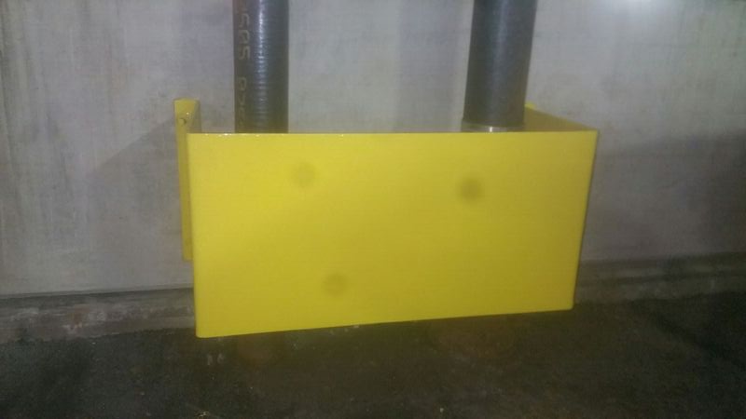
Context: Parking Maintenance Initiatives
Investing in the basics: painting, striping, sweeping, cleaning
First program of garage-wide power-washing and drain cleaning
Developing complete set of parking maintenance standards

Slide 8
Context: Real-time garage information
Real-time space availability will be live August 1 at:
Alewife, Beverly, Quincy Adams, Route 128, Salem, Wonderland, and Woodland garages

Slide 9
Context: MBTA Parking Prices Haven’t Changed in 10 Years, But Everything Else Has
Since 2009, Boston CPI has increased 14.2%.
Since 2012, Massport has increased parking prices by 50%.
Ridership and parking demand has increased substantially in the MBTA system

Slide 10
A Paradox: Too Little Demand, Too Much Demand
At underused facilities: Thousands of parking spaces sit empty over the course of a typical weekday or weekend
At overused facilities: Commuters have to arrive by 7:30 am (or earlier) to get a weekday parking spot

Slide 11
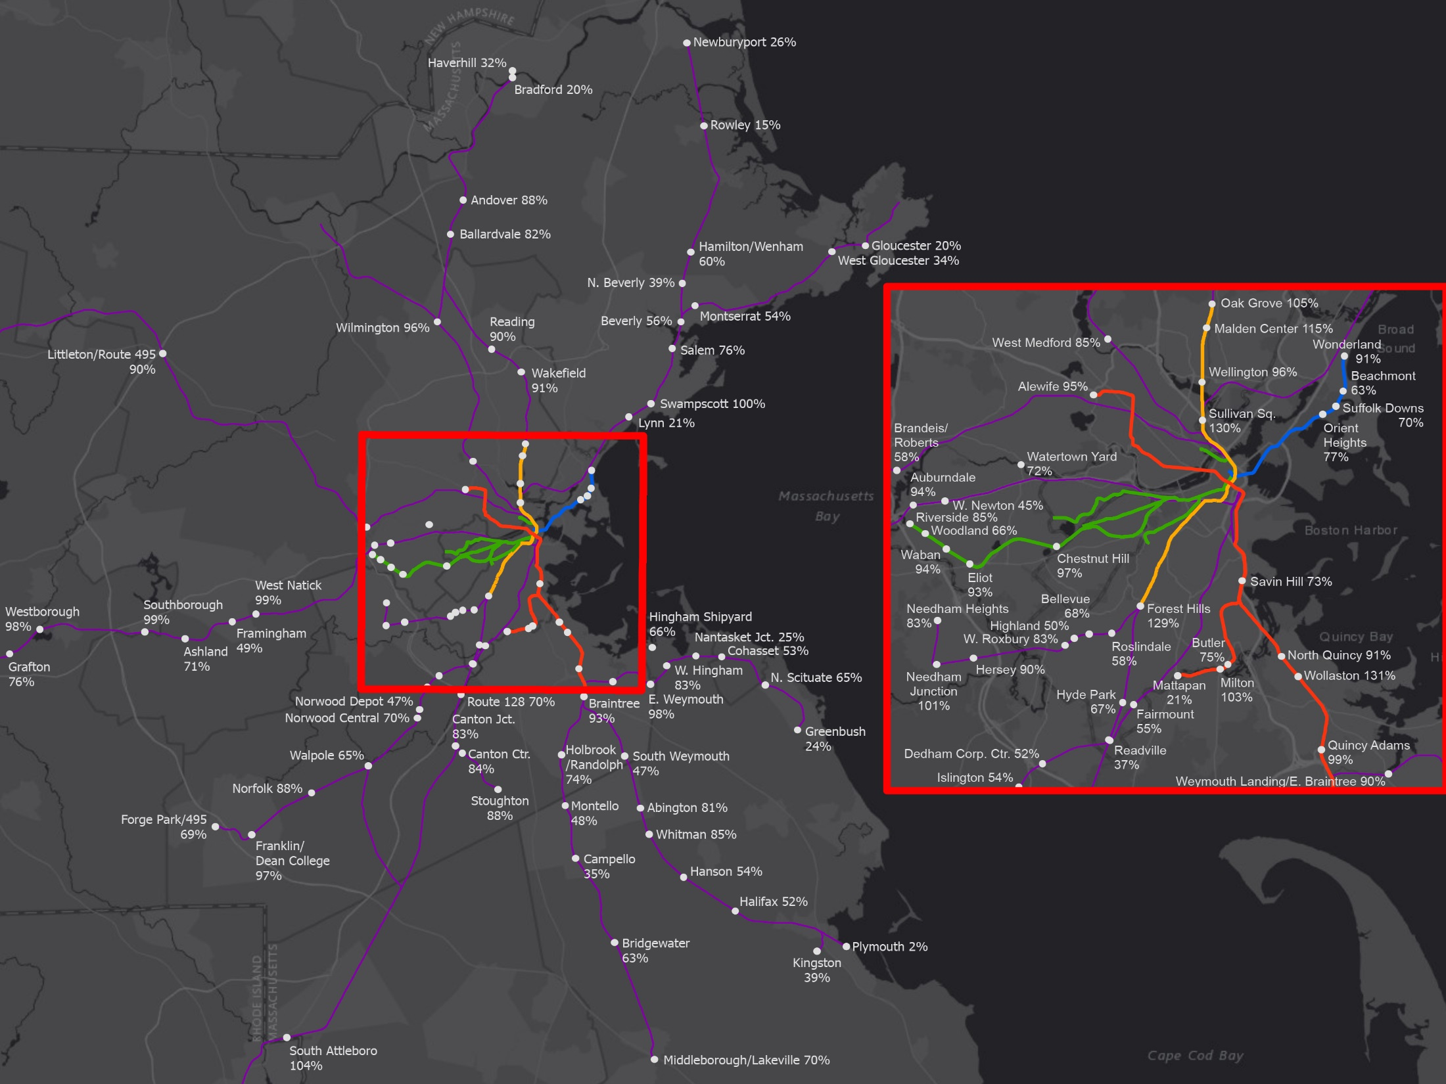
GRAPHIC: UTILIZATION PATTERNS
Weekday Parking Occupancy
Current weekday occupancy

Slide 12
Current weekend occupancy

Slide 13
A Paradox: Too Little Demand, Too Much Demand
At underused facilities: Thousands of parking spaces sit empty over the course of a typical weekday or weekend
At overused facilities: Commuters have to arrive by 7:30 am (or earlier) to get a weekday parking spot

Slide 14
By changing pricing, we can create more room for everyone
At underused facilities: Thousands of parking spaces sit empty over the course of a typical weekday or weekend
At overused facilities: Commuters have to arrive by 7:30 am (or earlier) to get a weekday parking spot
Reduce prices to encourage customers to use underused facilities
Maximizes use of parking spaces, encourages ridership, reduces regional congestion
Increase prices moderately to encourage customers to shift to underused facilities
Leads to better customer experience
More spots available at peak hours
Less circling around the lot
More revenue to invest in the system and provide amenities

Slide 15
Policy Goals
Following feedback from FMCB on March 26:
Provide more predictable weekday commutes by adjusting parking prices across the whole MBTA system, taking into account full cost of commute and overall utilization
Promote greater weekend and off-peak use of the system by establishing more varied rates and products (premium and event prices)
Advance system goals:
Delivery to service
Revenue generation
Improved customer experience
Closely monitor changes, transparently communicate, and collect feedback about any changes

Slide 16
Initial Policy Implementation

Slide 17
Pricing and policy implementation
In line with new parking policy, staff have developed balanced approaches that:
Cut many prices
Add new products
Aim to improve the customer experience by:
Encouraging use of parking facilities with more free space
Freeing up space at our busiest lots
Growing revenues to invest back into the system
Proposed implementation date: August 1, 2018

Slide 18
Under all options
Weekdays
21 facilities see price decreases
32 facilities see price increases
46 facilities remain the same
Weekends
98 facilities see 50% price decreases
1 facility remains the same

Slide 19
Weekday pricing – 3 options based on updated parking pricing policy and goals
Option 1:
Prices decrease up to 50%.
Maximum price is $10 per day (from $7)
Commuter rail lots increase maximum of $2 per day from current price.
Option 2:
Prices decrease up to 50%.
Maximum price is $9 per day (from $7)
Commuter rail lots increase maximum of $1 per day from current price.
Option 3:
Maximum price change of $1 decrease/increase at all facilities.

Slide 20
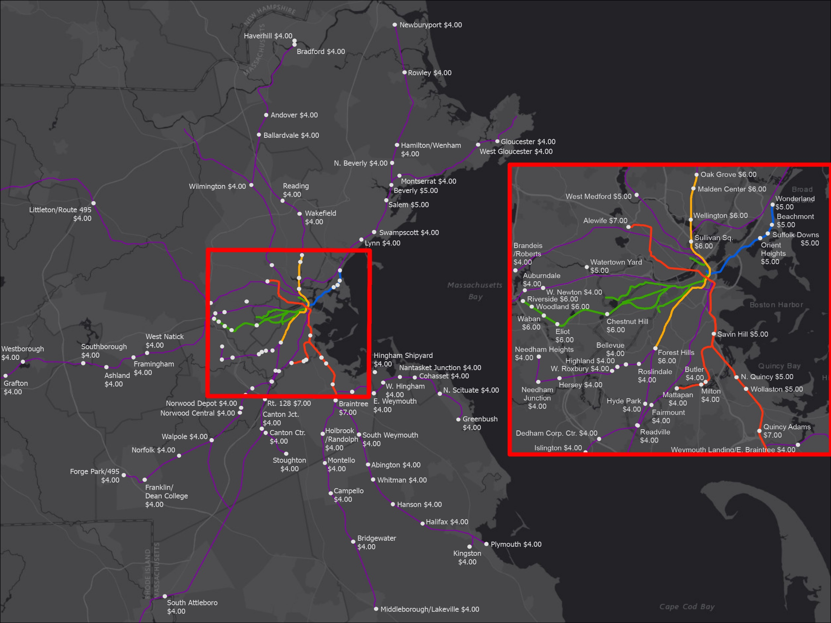
Current prices

Slide 21
Proposed weekend prices

Slide 22
Proposed weekday prices (option 2)

Slide 23
Proposed weekday prices (option 3)

Slide 24
GRAPHIC: UTILIZATION PATTERNS
Weekday Parking Occupancy
Current weekday occupancy

Slide 25
Predicted weekday occupancy
(option 2)

Slide 26
Predicted weekday occupancy
(option 3)

Slide 27
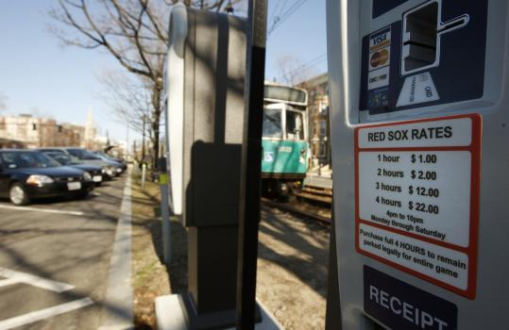
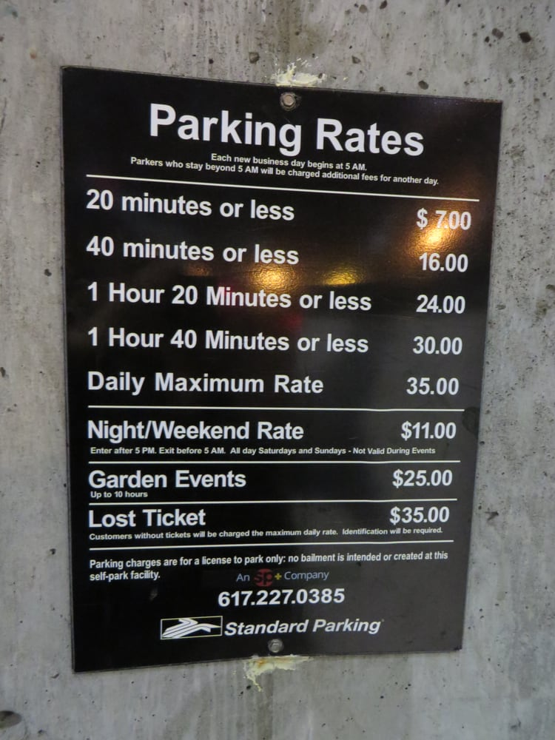
Event parking – still a great deal
Charging different rates for special events (like sports and concerts) – as is done in garages (and some towns)
Event rates ($2 above usual weekday rates) will start after regular commuting hours – so regular commuters will not be affected
Monthly parkers will not have to pay event prices
All locations, times, and events will be posted in advance
Monitor impact

Slide 28
Premium parking
Expanding our existing (limited) premium parking program across additional facilities
Currently only at 3 facilities
Customers can pay a little more for more convenient parking spots at larger facilities
Will explore guaranteed parking spots and other amenities
90%+ of spaces will continue to be general access
2017 Keolis Surveys demonstrated significant customer interest, depending on line:
Between 4%-21% of parking customers

Slide 29
Monthly, scofflaw, invoicing
Monthly Pricing
At facilities with monthly parking, adjusting prices to a consistent multiple of daily pricing
Fairer and clearer for our customers
Scofflaw Enforcement
Increasing enforcement for people with legitimate unpaid balances
To eventually include booting and towing (after ample notifications)
Invoicing
Change in invoicing price (from $0.50 to $1.00 per day) to reflect cost of providing service and to encourage PayByPhone usage
Over 80% of customers at unattended facilities pay with PayByPhone

Slide 30
Anticipated Revenue Impacts in FY19

Slide 31
Tradeoffs between options
More revenue vs less revenue
Revenue funds MBTA-wide priorities (and helps us pay for parking improvements, too)
Bigger price changes will likely lead:
Bigger ability to influence parking patterns
More predictable parking for customers
Easier to gauge impact

Slide 32
Indicative Pricing
 |  | OPTION 1 |  | OPTION 2 |  | OPTION 3
Station | Current Price | Mon - Fri | Sat - Sun | Mon - Fri | Sat - Sun | Mon - Fri | Sat - Sun
Abington | $4.00 | $4.00 | $2.00 | $4.00 | $2.00 | $4.00 | $2.00
Alewife | $7.00 | $10.00 | $3.00 | $9.00 | $3.00 | $8.00 | $3.00
Andover | $4.00 | $4.00 | $2.00 | $4.00 | $2.00 | $4.00 | $2.00
Ashland | $4.00 | $4.00 | $2.00 | $4.00 | $2.00 | $4.00 | $2.00
Auburndale | $4.00 | $6.00 | $2.00 | $5.00 | $2.00 | $5.00 | $2.00
Ballardvale | $4.00 | $4.00 | $2.00 | $4.00 | $2.00 | $4.00 | $2.00
Beachmont | $5.00 | $5.00 | $2.50 | $5.00 | $2.50 | $5.00 | $2.50
Bellevue | $4.00 | $4.00 | $2.00 | $4.00 | $2.00 | $4.00 | $2.00
Beverly Depot | $5.00 | $2.00 | $2.00 | $2.00 | $2.00 | $4.00 | $2.00
Bradford | $4.00 | $2.00 | $2.00 | $2.00 | $2.00 | $3.00 | $2.00
Braintree | $7.00 | $10.00 | $3.00 | $9.00 | $3.00 | $8.00 | $3.00
Brandeis/Roberts | $4.00 | $4.00 | $2.00 | $4.00 | $2.00 | $4.00 | $2.00
Bridgewater | $4.00 | $4.00 | $2.00 | $4.00 | $2.00 | $4.00 | $2.00
Butler | $4.00 | $4.00 | $2.00 | $4.00 | $2.00 | $4.00 | $2.00
Campello | $4.00 | $2.00 | $2.00 | $2.00 | $2.00 | $3.00 | $2.00
Canton Center | $4.00 | $4.00 | $2.00 | $4.00 | $2.00 | $4.00 | $2.00
Canton Junction | $4.00 | $4.00 | $2.00 | $4.00 | $2.00 | $4.00 | $2.00
Chestnut Hill | $6.00 | $9.00 | $3.00 | $9.00 | $3.00 | $7.00 | $3.00
Cohasset | $4.00 | $2.00 | $2.00 | $2.00 | $2.00 | $3.00 | $2.00
Dedham Corporate | $4.00 | $2.00 | $2.00 | $2.00 | $2.00 | $3.00 | $2.00
East Weymouth | $4.00 | $6.00 | $2.00 | $5.00 | $2.00 | $5.00 | $2.00
Eliot | $6.00 | $9.00 | $3.00 | $9.00 | $3.00 | $7.00 | $3.00
Fairmount | $4.00 | $4.00 | $2.00 | $4.00 | $2.00 | $4.00 | $2.00
Forest Hills | $6.00 | $9.00 | $3.00 | $9.00 | $3.00 | $7.00 | $3.00
Forge Park/Route 495 | $4.00 | $4.00 | $2.00 | $4.00 | $2.00 | $4.00 | $2.00
Framingham | $4.00 | $4.00 | $2.00 | $4.00 | $2.00 | $4.00 | $2.00
Franklin | $4.00 | $6.00 | $2.00 | $5.00 | $2.00 | $5.00 | $2.00
Gloucester | $4.00 | $2.00 | $2.00 | $2.00 | $2.00 | $3.00 | $2.00
Grafton | $4.00 | $4.00 | $2.00 | $4.00 | $2.00 | $4.00 | $2.00
Greenbush | $4.00 | $2.00 | $2.00 | $2.00 | $2.00 | $3.00 | $2.00
Halifax | $4.00 | $2.00 | $2.00 | $2.00 | $2.00 | $3.00 | $2.00
Hamilton/Wenham | $4.00 | $4.00 | $2.00 | $4.00 | $2.00 | $4.00 | $2.00
Hanson | $4.00 | $4.00 | $2.00 | $4.00 | $2.00 | $4.00 | $2.00
Haverhill | $4.00 | $2.00 | $2.00 | $2.00 | $2.00 | $3.00 | $2.00
Hersey | $4.00 | $4.00 | $2.00 | $4.00 | $2.00 | $4.00 | $2.00
Highland | $4.00 | $4.00 | $2.00 | $4.00 | $2.00 | $4.00 | $2.00
Hingham Shipyard | $4.00 | $2.00 | $2.00 | $2.00 | $2.00 | $3.00 | $2.00
Holbrook/Randolph | $4.00 | $4.00 | $2.00 | $4.00 | $2.00 | $4.00 | $2.00
Hyde Park | $4.00 | $4.00 | $2.00 | $4.00 | $2.00 | $4.00 | $2.00
Islington | $4.00 | $4.00 | $2.00 | $4.00 | $2.00 | $4.00 | $2.00
Kingston/Route 3 | $4.00 | $4.00 | $2.00 | $4.00 | $2.00 | $4.00 | $2.00
Littleton/Route 495 | $4.00 | $6.00 | $2.00 | $5.00 | $2.00 | $5.00 | $2.00
Lynn | $4.00 | $2.00 | $2.00 | $2.00 | $2.00 | $3.00 | $2.00
Malden Center | $6.00 | $7.50 | $3.00 | $7.00 | $3.00 | $7.00 | $3.00
Mattapan | $4.00 | $2.00 | $2.00 | $2.00 | $2.00 | $3.00 | $2.00
Middleborough/Lakeville | $4.00 | $4.00 | $2.00 | $4.00 | $2.00 | $4.00 | $2.00
Milton | $4.00 | $6.00 | $2.00 | $6.00 | $2.00 | $5.00 | $2.00
Montello | $4.00 | $2.00 | $2.00 | $2.00 | $2.00 | $3.00 | $2.00
 |  | OPTION 1 |  | OPTION 2 |  | OPTION 3
Station | Current Price | Mon - Fri | Sat - Sun | Mon - Fri | Sat - Sun | Mon - Fri | Sat - Sun
Montserrat | $4.00 | $4.00 | $2.00 | $4.00 | $2.00 | $4.00 | $2.00
Nantasket Junction | $4.00 | $2.00 | $2.00 | $2.00 | $2.00 | $3.00 | $2.00
Needham Heights | $4.00 | $4.00 | $2.00 | $4.00 | $2.00 | $4.00 | $2.00
Needham Junction | $4.00 | $6.00 | $2.00 | $5.00 | $2.00 | $5.00 | $2.00
Newburyport | $4.00 | $4.00 | $2.00 | $4.00 | $2.00 | $4.00 | $2.00
Norfolk | $4.00 | $4.00 | $2.00 | $4.00 | $2.00 | $4.00 | $2.00
North Beverly | $4.00 | $4.00 | $2.00 | $4.00 | $2.00 | $4.00 | $2.00
North Quincy Hancock St | $5.00 | $7.50 | $3.00 | $7.50 | $3.00 | $6.00 | $2.50
North Quincy Newport Ave | $5.00 | $7.50 | $3.00 | $7.50 | $3.00 | $6.00 | $2.50
North Scituate | $4.00 | $4.00 | $2.00 | $4.00 | $2.00 | $4.00 | $2.00
Norwood Central | $4.00 | $4.00 | $2.00 | $4.00 | $2.00 | $4.00 | $2.00
Norwood Depot | $4.00 | $2.00 | $2.00 | $2.00 | $2.00 | $3.00 | $2.00
Oak Grove | $6.00 | $9.00 | $3.00 | $9.00 | $3.00 | $7.00 | $3.00
Orient Heights | $5.00 | $5.00 | $2.50 | $5.00 | $2.50 | $5.00 | $2.50
Plymouth | $4.00 | $2.00 | $2.00 | $2.00 | $2.00 | $3.00 | $2.00
Quincy Adams | $7.00 | $10.00 | $3.00 | $9.00 | $3.00 | $8.00 | $3.00
Reading | $4.00 | $6.00 | $2.00 | $5.00 | $2.00 | $5.00 | $2.00
Readville | $4.00 | $2.00 | $2.00 | $2.00 | $2.00 | $3.00 | $2.00
Riverside | $6.00 | $6.00 | $3.00 | $6.00 | $3.00 | $6.00 | $3.00
Roslindale Village | $4.00 | $4.00 | $2.00 | $4.00 | $2.00 | $4.00 | $2.00
Route 128 | $7.00 | $7.00 | $3.00 | $7.00 | $3.00 | $7.00 | $3.00
Rowley | $4.00 | $2.00 | $2.00 | $2.00 | $2.00 | $3.00 | $2.00
Salem* | $5.00 | $5.00 | $2.00 | $5.00 | $2.00 | $5.00 | $2.00
Savin Hill | $5.00 | $7.50 | $2.50 | $7.50 | $2.50 | $6.00 | $2.50
South Attleboro | $4.00 | $6.00 | $2.00 | $5.00 | $2.00 | $5.00 | $2.00
South Weymouth | $4.00 | $2.00 | $2.00 | $2.00 | $2.00 | $3.00 | $2.00
Southborough | $4.00 | $6.00 | $2.00 | $5.00 | $2.00 | $5.00 | $2.00
Stoughton | $4.00 | $4.00 | $2.00 | $4.00 | $2.00 | $4.00 | $2.00
Suffolk Downs | $5.00 | $2.50 | $2.50 | $2.50 | $2.50 | $4.00 | $2.50
Sullivan Square | $6.00 | $9.00 | $6.00 | $9.00 | $6.00 | $7.00 | $6.00
Swampscott | $4.00 | $6.00 | $2.00 | $5.00 | $2.00 | $5.00 | $2.00
Waban | $6.00 | $9.00 | $3.00 | $9.00 | $3.00 | $7.00 | $3.00
Wakefield | $4.00 | $6.00 | $2.00 | $5.00 | $2.00 | $5.00 | $2.00
Walpole | $4.00 | $4.00 | $2.00 | $4.00 | $2.00 | $4.00 | $2.00
Watertown Yard | $5.00 | $5.00 | $2.50 | $5.00 | $2.50 | $5.00 | $2.50
Wellington | $6.00 | $9.00 | $4.00 | $7.00 | $4.00 | $7.00 | $3.00
West Gloucester | $4.00 | $2.00 | $2.00 | $2.00 | $2.00 | $3.00 | $2.00
West Hingham | $4.00 | $4.00 | $2.00 | $4.00 | $2.00 | $4.00 | $2.00
West Medford | $5.00 | $5.00 | $2.00 | $5.00 | $2.00 | $5.00 | $2.50
West Natick | $4.00 | $6.00 | $2.00 | $5.00 | $2.00 | $5.00 | $2.00
West Newton Washington St | $4.00 | $4.00 | $2.00 | $4.00 | $2.00 | $4.00 | $2.00
West Newton Webster St | $4.00 | $4.00 | $2.00 | $4.00 | $2.00 | $4.00 | $2.00
West Roxbury | $4.00 | $6.00 | $2.00 | $5.00 | $2.00 | $5.00 | $2.00
Westborough | $4.00 | $6.00 | $2.00 | $5.00 | $2.00 | $5.00 | $2.00
Weymouth Landing/East Braintree | $4.00 | $4.00 | $2.00 | $4.00 | $2.00 | $4.00 | $2.00
Whitman | $4.00 | $6.00 | $2.00 | $5.00 | $2.00 | $5.00 | $2.00
Wilmington | $4.00 | $6.00 | $2.00 | $5.00 | $2.00 | $5.00 | $2.00
Wollaston | $5.00 | $5.00 | $2.50 | $5.00 | $2.50 | $5.00 | $2.50
Wonderland Garage | $5.00 | $7.00 | $2.00 | $7.00 | $2.00 | $6.00 | $2.00
Wonderland Surface | $5.00 | $7.00 | $2.00 | $7.00 | $2.00 | $6.00 | $2.00
Woodland | $6.00 | $6.00 | $3.00 | $6.00 | $3.00 | $6.00 | $3.00

Slide 33
To Vote - DRAFT
To authorize the General Manager or designee to take all necessary steps to implement the MBTA Parking Policy, and to implement initial pricing changes effective August 1, 2018 in accordance with Option ___ as presented at this June 18th, 2018 meeting.

