Slide 1
Winter 2022 Service Changes
December 2021
Zoom

Slide 2
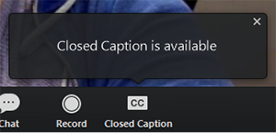
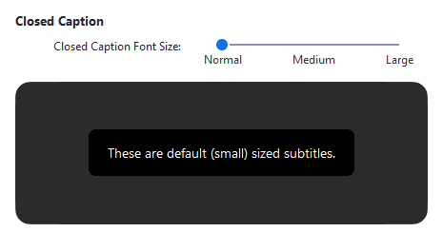
Closed Captions
Click Closed Caption to start viewing closed captioning
Tip: Click and drag the closed captioning to move its position in the meeting window.
To adjust the caption size:
Click the upward arrow next to Start Video / Stop Video.
Click Video Settings then Accessibility.
Move the slider to adjust the caption size

Slide 3
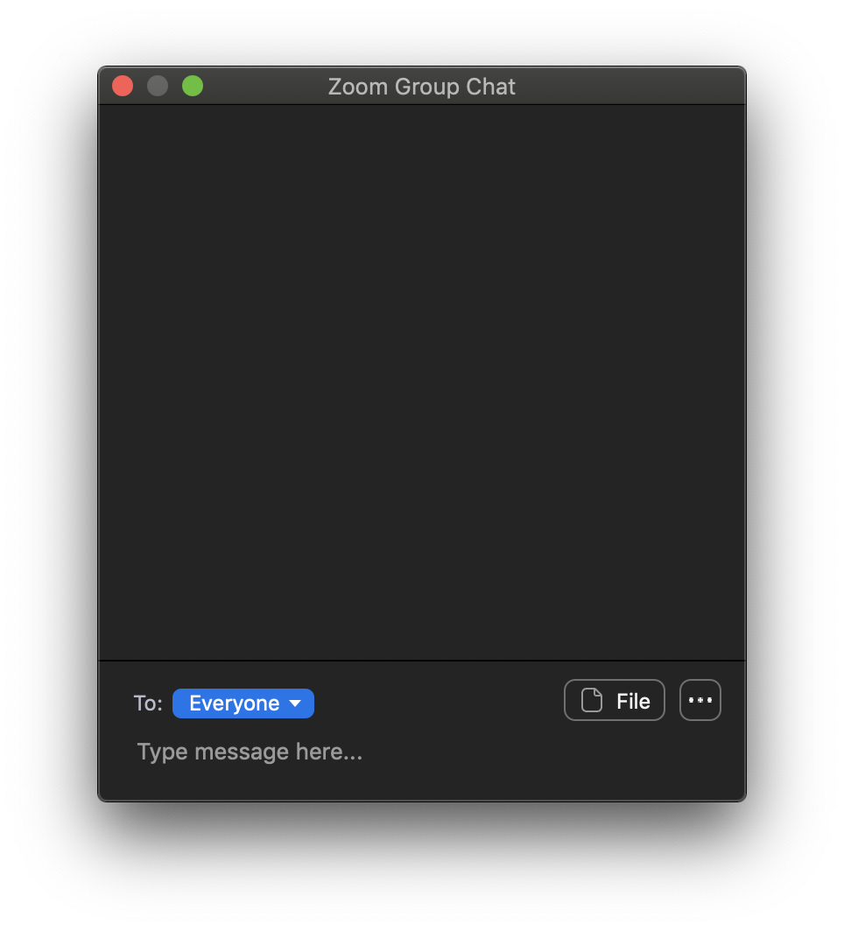
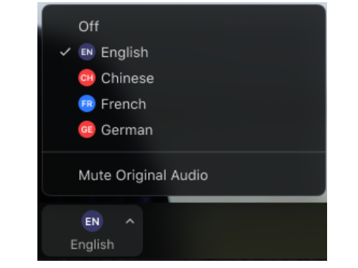
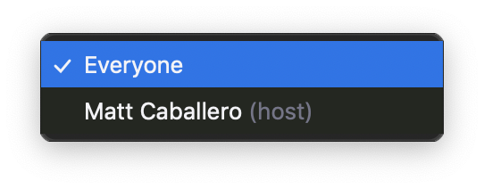
Use Chat for Technical Questions
If you have a technical question about Zoom or the features of the meeting, please use the chat function.
Our technical assistant will attempt to troubleshoot your problem and get back to you.
We also offer Spanish interpretation during this meeting. In order to select English or Spanish audio In your meeting/webinar controls, click Interpretation and Click the language that you would like to hear

Slide 4
MBTA Participation
Angel Donahue-Rodriguez
Deputy Chief of Staff
Kat Benesh
Chief of Operations Strategy, Policy & Oversight
Melissa Dullea
Senior Director of Service Planning
Terrie Chan
Community Liaison
Makayla Comas
Community Liaison

Slide 5
Overview
MBTA faces a significant workforce shortage, driven by national hiring trends and internal challenges
This is not a cost control measure – the MBTA is budgeted for full level of services
We are currently unable to deliver existing scheduled bus service, and are dropping one out of every 20 trips
New Winter schedule represents ~90.5% of pre-COVID service hours
Our Fall bus schedule assumes ~93.5% of pre-COVID service hours, so this change represents ~3% reduction
This winter, we will be rebalancing our bus service so that scheduled service better matches the level of reliable service we can deliver, while still focusing on:
Preserving access and quality of service for transit critical riders
Providing sufficient service for returning riders to in-person school or work opportunities
Supporting new and changing travel patterns
Re-balancing service is not our only lever - to enable the MBTA to return to higher levels of service, we are aggressively pursuing internal and external efforts to increase our workforce

Slide 6
Winter Schedule Changes Background
The service we planned to provide this fall is not the service we are running; we are dropping trips (i.e. not running them) due to operator shortages.
Dropping trips results in poor reliability and uneven headways (space between buses)
Our goal is to provide more evenly spaced service that is more reliable with less risk of unpredictable crowding from dropped trips.
Example: Fall 2021—high frequency routes scheduled for every 10 minutes, but often trips are missed leaving 20-minute gaps
Example: Winter 2022, with frequency changes—high frequency routes are scheduled for every 12 minutes instead, with less likelihood of missed trips
10 minutes
10 minutes
10 minutes
10 minutes
10 minutes
10 minutes
10 minutes
10 minutes
12 minutes
12 minutes
12 minutes
12 minutes
12 minutes
12 minutes

Slide 7
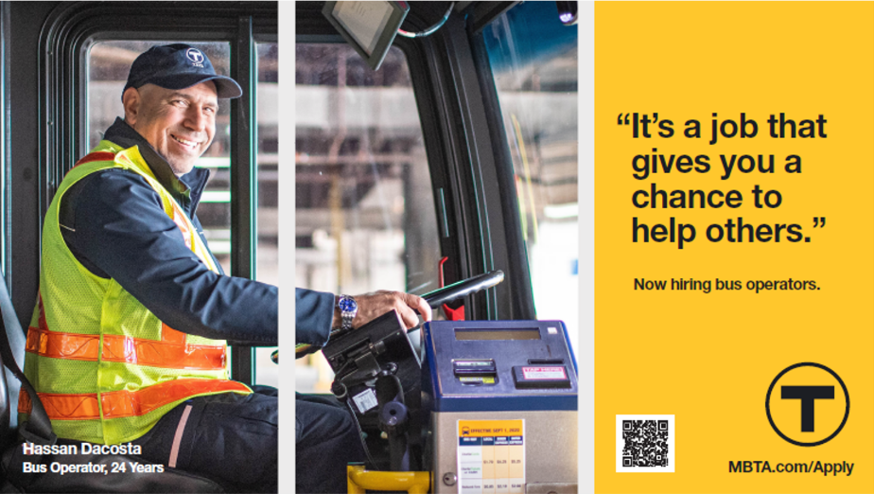
Efforts Underway to Increase HR Capacity and Hiring
More then doubling size of HR recruiting department (10 new recruiters brought on since Labor Day with more joining shortly)
Created and staffed a dedicated team for Operator hiring
Onboarded HR staff augmentation firm to allow for additional hiring support
Launched major HR improvement initiatives this Summer / Fall
CDL permit ‘events’ at RMV, revamping interview process, streamlining application process etc.
Revamped advertising and marketing campaigns
Working with unions and executives on methods for making Bus Operator jobs more appealing for applicants
Promoted 75 part-time operators to full-time status for winter schedule, in order to gain more productivity from existing workforce and to make work more appealing to help attract and retain talent

Slide 8
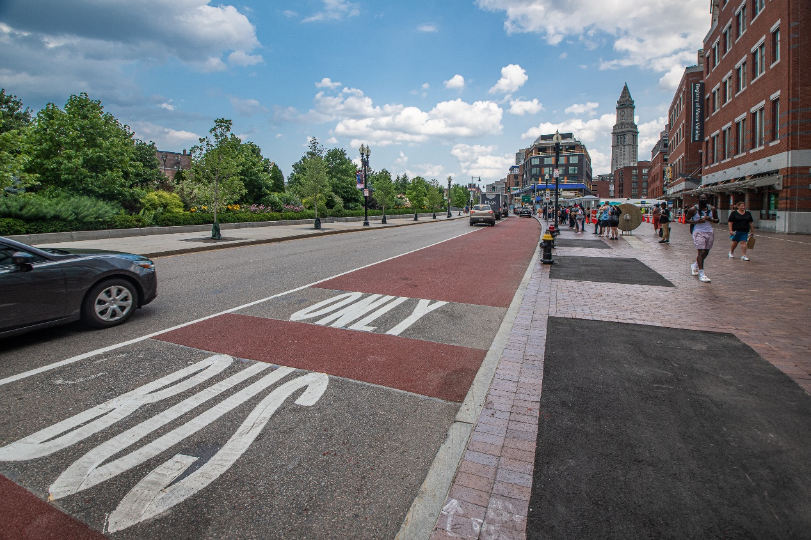
Winter 2022 Service Changes
This winter, as riders are returning to the MBTA we are. These changes will:
Optimize service with limited resources
Allow flexibility to make changes based on what we observe this winter
Overall, this represents 3% less service vs. pre-COVID service hours
Photo of a “Bus Only” Lane

Slide 9
Mode Specific Service Changes

Slide 10
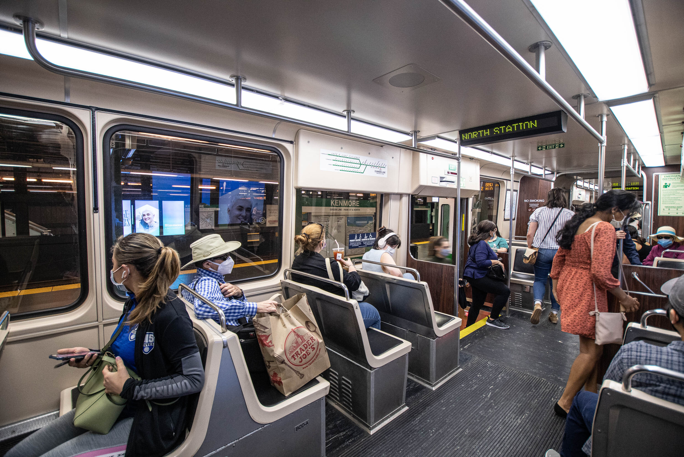
Subway

Slide 11
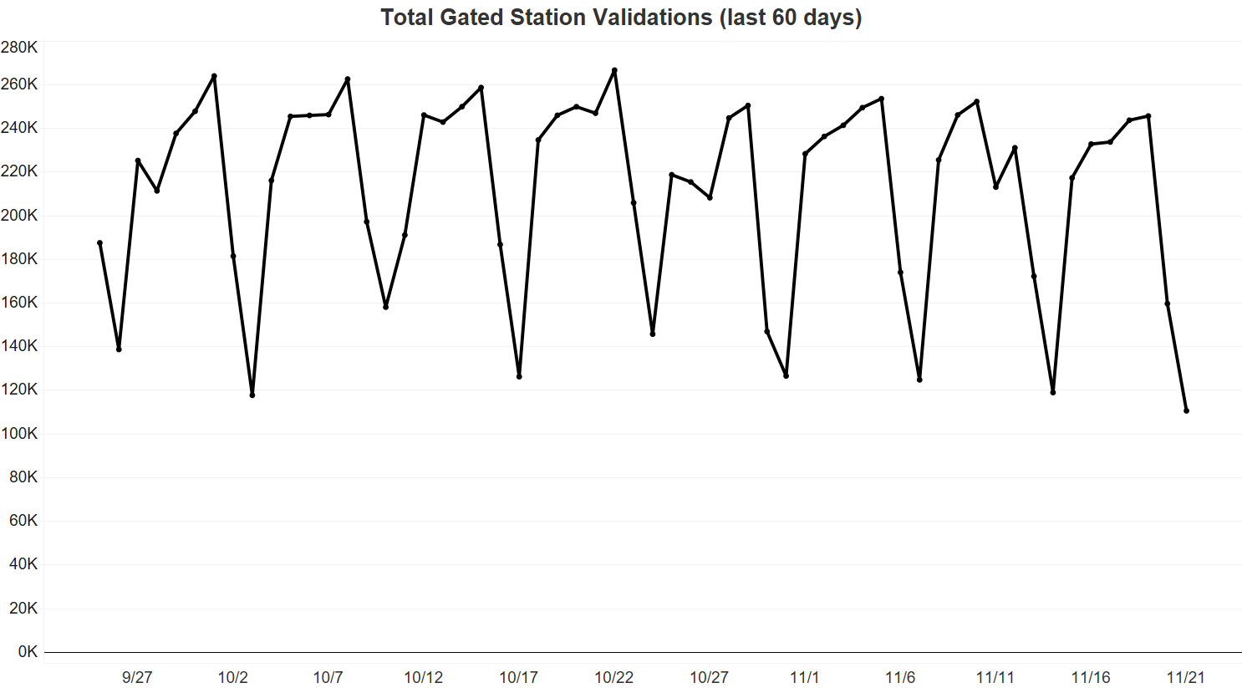
Gated Rapid Transit Stations
Line | Change in validations: November 2019 weekday average vs. weekday average for November 15-19, 2021
Blue Line | -49%
Green Line | -52%
Orange Line | -52%
Red Line | -51%
Total Gated Stations | -51%
Gated validations data by line and station are available in this public folder and continue to be updated on the Data Blog. The data is also continuously updated and visualized on the MassDOT Mobility Dashboard.

Slide 12
Winter 2022 Subway Service Changes
Mattapan Trolley
Schedules will be adjusted to reflect actual peak service levels provided since 2018; off-peak service levels will also be increased
Frequency reduces from every 5 to every 7 minutes during the AM and PM peaks weekdays.
Frequency increases from every 23 to every 13 minutes in the late evenings on Saturdays and Sundays (after 11:30 PM).
Minor trip shifts throughout the day on weekdays, Saturdays, and Sundays.
Visit www.MBTA.com/schedules/subway to view subway schedules.
Changes will go into effect on December 19th .
Notes:
Done

Slide 13
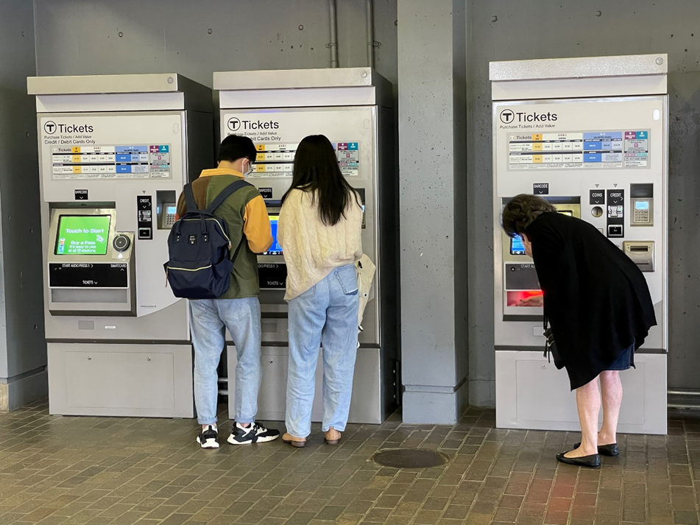
Fare Transformation – Upgraded Fare Vending Machines
Upgraded Fare Vending Machines have been installed in all Orange and Blue Line stations.
Upgrades include:​
The ability to purchase or reload CharlieCards
The introduction of the new tappable CharlieTicket​
Tap and go at fare gates & fare boxes with the tappable symbol​
Phase out of the insertable CharlieTicket during transition​
Contactless and mobile pay options​
Contactless Credit/Debit Cards​
Apple Pay, Google Pay, Samsung Pay​
For more information, visit:​
https://www.mbta.com/fares/fare-transformation ​
Orange Line | Fall 2021 - Complete
Blue Line | Winter 2021 - Complete
Red Line | Winter 2021
Silver Line | Spring 2022
Green Line | Spring 2022

Slide 14
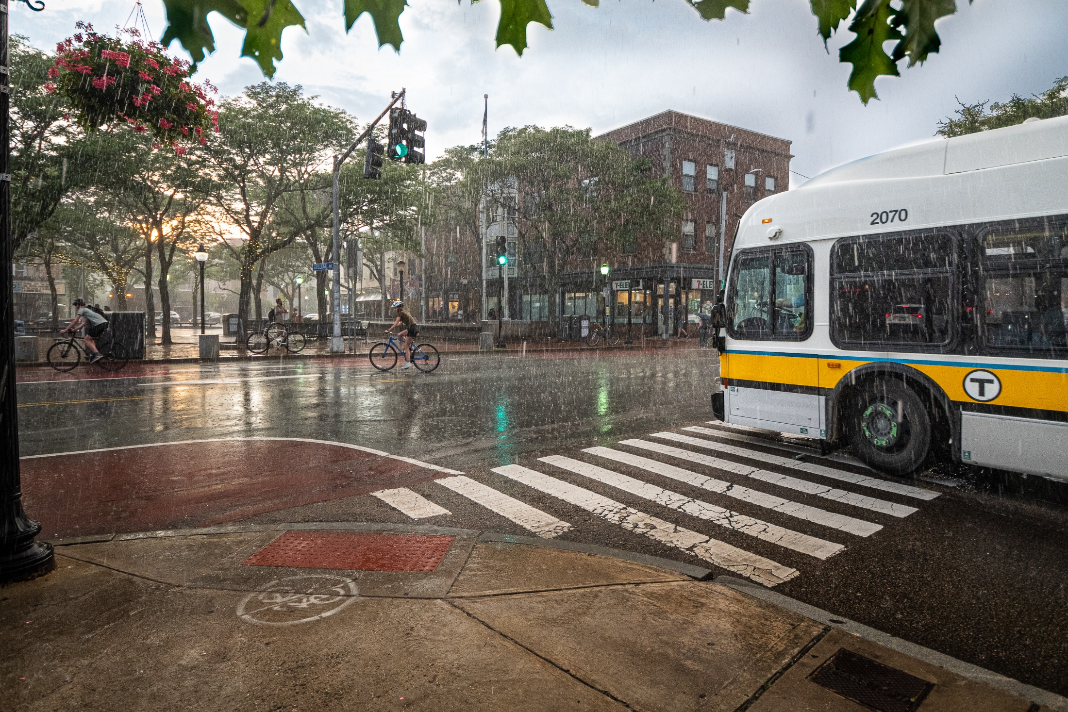
Bus

Slide 15
Bus Ridership Trends
Ridership estimated from APCs.
Ridership for the most recent days is continuously revised as information on dropped trips is received.
Notes:
Done

Slide 16
Bus Ridership Top Routes
*This chart displays average daily ridership by week, representing the most recent week available. The included routes represent the current top 20 as well as the top 20 routes pre-COVID.

Slide 17
Winter 2022 Bus Service Changes
Strategy: Reduce scheduled frequency to match current operator availability and reduce long gaps/dropped trips, increase scheduled service where crowding is most severe, and restore some services to accommodate growing in-person school and work trips.
Note: Many bus routes that see a reduction in scheduled service will still be running more service than pre-COVID
Visit https://www.mbta.com/schedules/bus to view bus schedules.
Changes will go into effect on December 19th.

Slide 18
Winter 2022 Bus Service Changes
What’s changing | Routes affected
Routes with structure changes | 62, 76 restored in peak periods; combined 62/76 remain off-peaks. 111 runs full Woodlawn trips all-day instead of 111C/111 combination. 116/117 and 108 also have fewer short-turn trips.
Routes with increased frequency | 19, 38, SL1
Routes with mix of added frequency & reductions | 66 – Frequency reductions in the AM and PM peaks weekdays and on Saturday evenings. Sunday inbound trip added at 5:54 AM. 111 – Frequency reductions in Cary Square-Haymarket segment, but increases from Woodlawn to Cary Square.
Routes with reduced frequency | 1, 7, 9, 11, 15, 22, 23, 29, 30, 31, 42, 47, 65, 70, 77, 86, 87, 88, 104, 106, 108, 109, 116, 117, 240, 442, 455, 501, 504, 505, CT3
For additional details, please visit www.MBTA.com/servicechanges.
Changes will go into effect on December 19th.
Notes:
Done

Slide 19
Winter 2022 Bus Service Changes
What’s changing | Routes affected
Routes with minor trip shifts If your route or stop is affected, please use the MBTA trip planner to plan alternative service. | 8, 10, 14, 28, 32, 35, 39, 52, 55, 57, 61, 64, 69, 83, 85, 89, 92, 93, 94, 95, 97, 99, 100, 101, 105, 110, 112, 132, 134, 216, 217, 222, 238, 351, 354, 428, 429, 456, SL2, SL3
For additional details, please visit www.MBTA.com/servicechanges.
Changes will go into effect on December 19th.
Notes:
Done

Slide 20
Next steps
December 8th: Public meeting on upcoming changes ✓
December 19th: New winter schedules take effect on bus and subway
November – December: review new ridership, crowding, public feedback, internal feedback, and hiring projections and recommend if and how to add back service for Spring 2022 schedule changes
Notes:
Done

Slide 21
Raising Your Hand
2:00
2:00
1:59
1:58
1:57
1:56
1:55
1:54
1:53
1:52
1:51
1:50
1:49
1:48
1:47
1:46
1:45
1:44
1:43
1:42
1:41
1:40
1:39
1:38
1:37
1:36
1:35
1:34
1:33
1:32
1:31
1:30
1:29
1:28
1:27
1:26
1:25
1:24
1:23
1:22
1:21
1:20
1:19
1:18
1:17
1:16
1:15
1:14
1:13
1:12
1:11
1:10
1:09
1:08
1:07
1:06
1:05
1:04
1:03
1:02
1:01
1:00
0:59
0:58
0:57
0:56
0:55
0:54
0:53
0:52
0:51
0:50
0:49
0:48
0:47
0:46
0:45
0:44
0:43
0:42
0:41
0:40
0:39
0:38
0:37
0:36
0:35
0:34
0:33
0:32
0:31
0:30
0:29
0:28
0:27
0:26
0:25
0:24
0:23
0:22
0:21
0:20
0:19
0:18
0:17
0:16
0:15
0:14
0:13
0:12
0:11
0:10
0:09
0:08
0:07
0:06
0:05
0:04
0:03
0:02
0:01
Time Elapsed
Please use Zoom’s “Raise Hand” feature to indicate if you have a comment. If you have a comment, please raise your hand and wait for the moderator to give you permission to speak.
By default, all attendees are muted so that only the presenters can be heard. When you raise your hand, it alerts the moderator that you’d like to speak. The moderator will unmute attendees to ask questions in the order that they raised their hands.
To speak, click “Participants” then “Raise hand”
Send a chat
to the moderator
*9
Raise Hand

Slide 22
Continue Getting Involved
MBTA Customer Opinion Panel:
Whether or not you’ve been riding the T recently, your input can help us ensure we’re prepared to respond to the changing transportation needs of the region.
Join our monthly customer opinion panel survey to give us feedback about how we're doing, what we can do better, and how we can plan for the future.
www.mbta.com/survey
Upcoming Events:
Dedham East Street Bridge Replacement – Dec 9
Arborway Bus Maintenance Facility – Dec 9
Winchester Center Station – Dec 15
More details at www.mbta.com/events

Slide 23
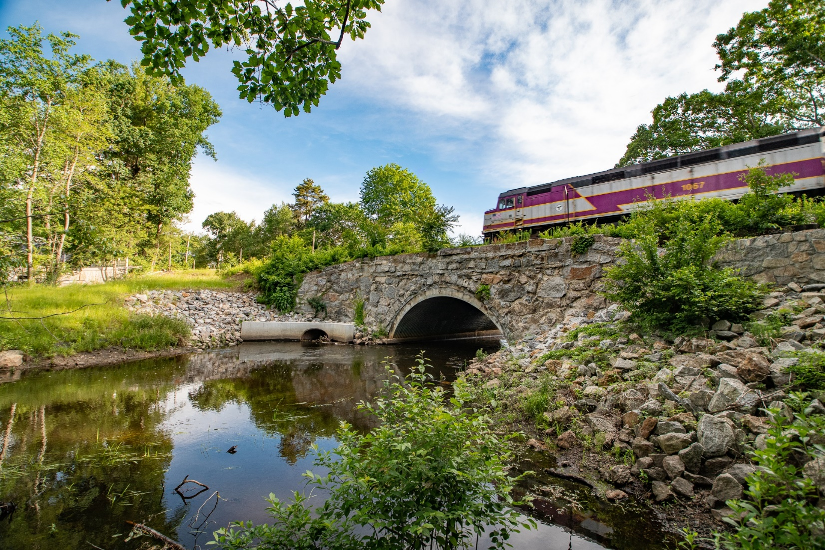
Thank you!
Email the MBTA Community Engagement team at publicengagement@mbta.com.
www.mbta.com

